Slide 1
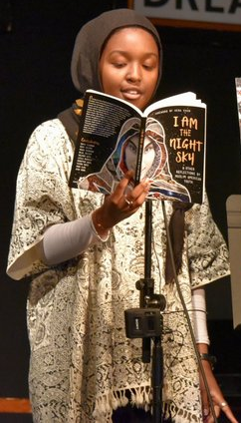

Muslim American Youth
Voices: I Am the Night Sky
Book Workshop for
Educators
Notes:
https://www.shoutmousepress.org/nwmi/#project

Slide 2




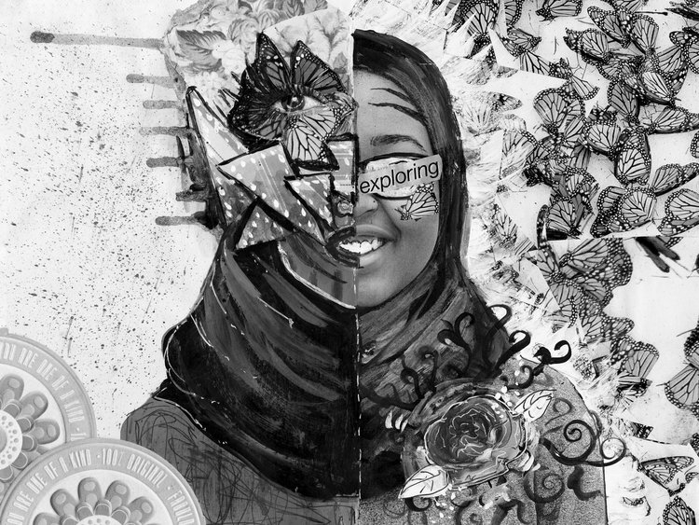
Welcome!
أهلا بك!

Slide 3
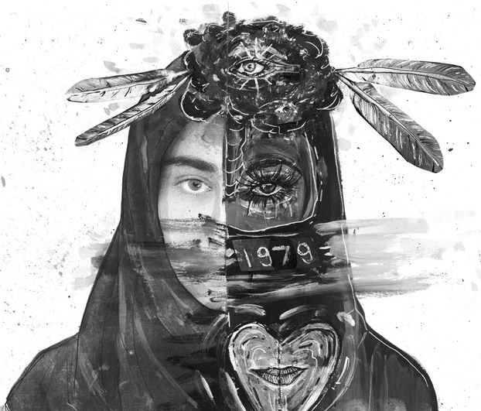
Agenda
5:00 - 5:15 - Refreshments & Book Handout
5:15 - 5:20 - Welcome & Introductions
5:20 - 5:45 - Fishbowl Discussion
5:45 - 6:30 - Classroom Implementation
6:30 - 7:00 - Book Signing

Slide 4
PANELISTS
Tiferet Ani
Kathy Crutcher
Mona Eldadah
Noor Saleem
Bilal Saleem
Salihah “Sasa” Aakil

Slide 5
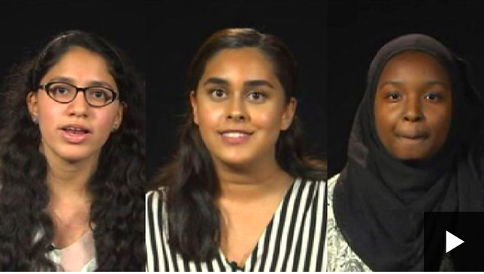
BBC News Story about I Am the Night Sky

Slide 6
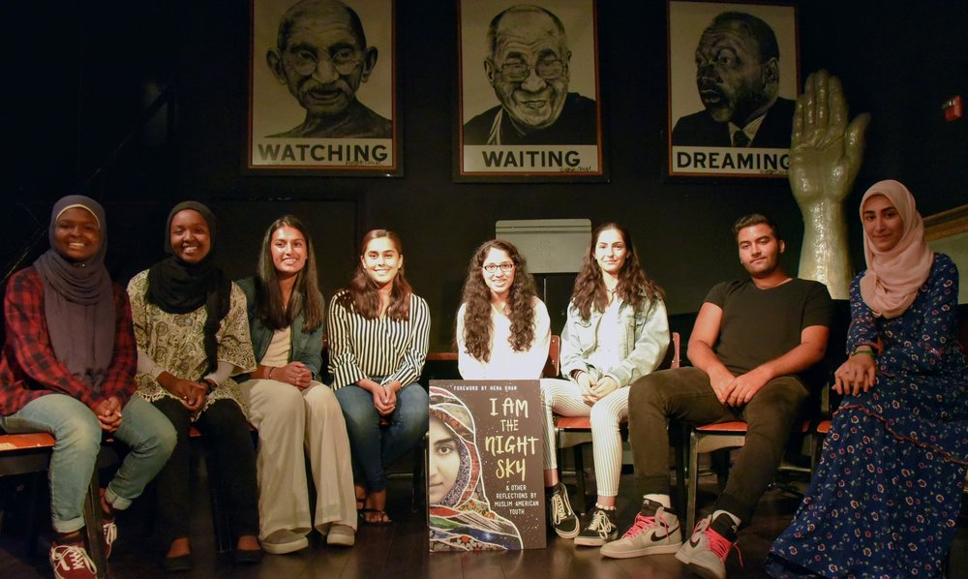
The Authors

Slide 7
“Stories matter. Many stories matter.
Stories have been used to dispossess and malign, but stories can also be used to empower and humanize. Stories can break the dignity of people, but stories can also repair that broken dignity.”
- Chimamanda Ngozi Adiche

Slide 8
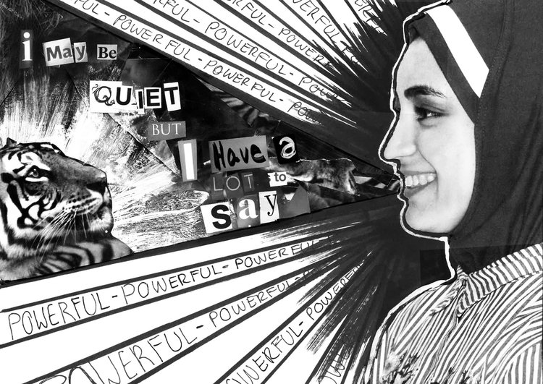
1.
Fishbowl Discussion
Panelists:
Kathy Crutcher, Shout Mouse Press
Mona Eldadah, Next Wave Muslim Initiative
Salihah Aakil, student author
Noor Saleem, student author
Bilal Saleem, student author

Slide 9
Which Theme is reflected in your work? Why does it resonate with you?
multiple identities
challenging assumptions
belonging/
acceptance
Outsider/
Othering
Finding Balance
Notes:
multiple identities, belonging, balance, challenging assumptions, and acceptance

Slide 10
Mona & Kathy, What theme did you know had to be in the book? Why?
multiple identities
challenging assumptions
belonging/
acceptance
Outsider/
Othering
Finding Balance
Notes:
multiple identities, belonging, balance, challenging assumptions, and acceptance

Slide 11
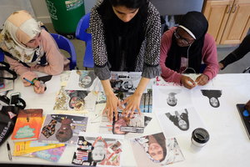
Why was it important for the book to include multimedia works? How does the artwork augment the messages and impact of the book?

Slide 12
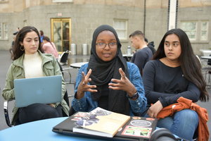
What do you want teachers
and students to understand and learn when they read this?

Slide 13
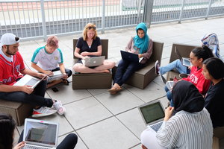
How has contributing to the book impacted you?

Slide 14
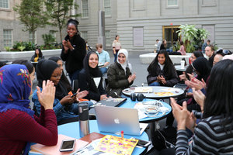
Classroom ImplementatioN
Alison Kysia, Marya Hay, Manal Agabein, & Farhana N. Shah

Slide 15
How did it make you feel to read and respond to these questions?
Notes:
How did it make you feel to read these questions?
How did it make you feel to respond to it?
Think about the perspectives you read how might those experiences impact the students connection and readiness for learning . . . feeling of acceptance, being visible and acknowledged.
How do you foster the climate and conditions to have these conversations with your students? What needs to be in place?

Slide 16
What are the consequences of not having open conversations that acknowledge how these themes impact students’ everyday lives?
Think about the perspectives you read, how might those Feelings influence the student’s connection to school and readiness for learning?

Slide 17
How do you foster the climate and conditions to have these conversations with your students? What needs to be in place?
Notes:
How do you foster the climate and conditions to have these conversations with your students? What needs to be in place?

Slide 18
Resources
CHALLENGE ISLAMOPHOBIA PROJECT
Free and downloadable lesson plans from DC-based Teaching for Change that address both interpersonal and structural discrimination against Muslims and those targeted as Muslim.
MUSLIM ANTI-RACISM COLLABORATIVE
A non-profit education organization with the mission of providing racial justice education and resources to advance racial justice inside and outside Muslim communities.
NEXT WAVE MUSLIM INITIATIVE
NWMI is a non-profit organization that serves the needs of the diverse American Muslim communities in the Washington DC metro area in order to nurture the next generation.

Slide 19
MCPS Resources
Commemorations 2019-2020
A calendar of religious and cultural holidays to help you plan for the year - includes dates, videos, classroom resources and personal essays about the different events.
Create the Conditions for Conversations about Sensitive Issues
Strategies & resources for engaging in personal reflection, facilitating dialogue, and creating community agreements from the Equity Initiatives Unit.
A Guide to Discussing Sensitive Topics in the Classroom
Before, during, and after discussion tips & resources from MCPS Social Studies.

Slide 20
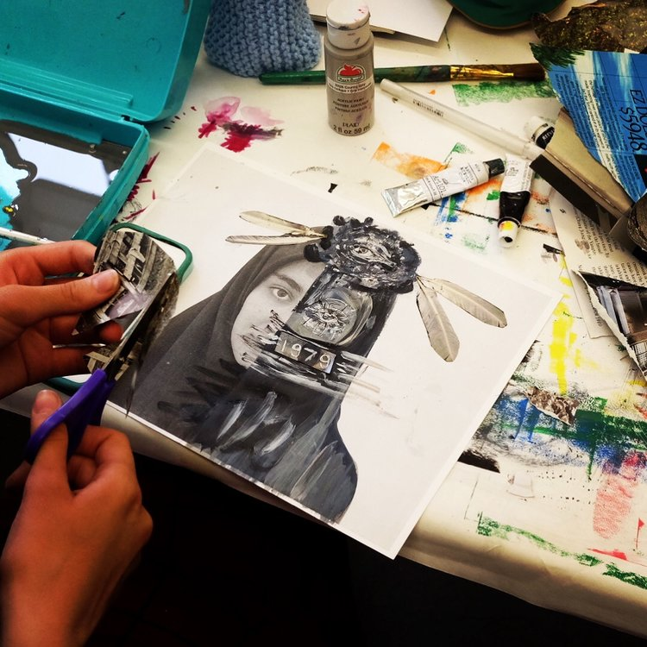
Professional Development for MCPS Staff
Islam 101
November 21, 2019
8:30 - 3:30
PDO Course # 88458
Taught by Manal Agabein & Farhana Shah, White Oak MS

Slide 21
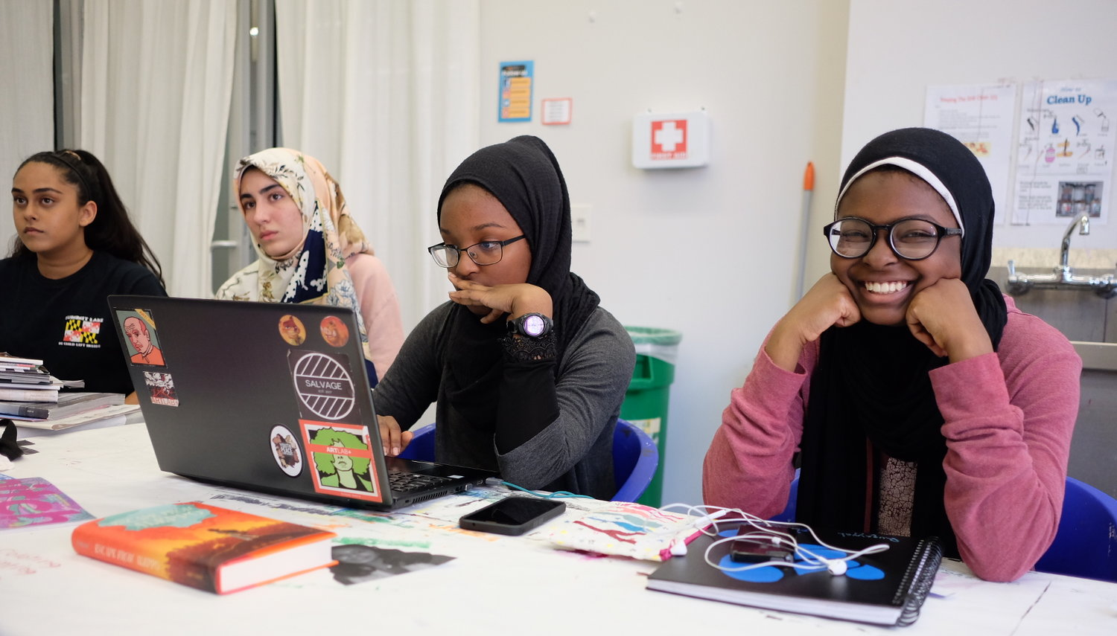
Thanks for joining us!
شكرا لانضمامك إلينا!

Slide 22
FEEL FREE TO REACH OUT
ALISON KYSIA, OUTREACH COORDINATOR, INSTITUTE FOR MIDDLE EAST STUDIES AT GWU
IMES_OUTREACH@GWU.EDU

