Slide 1
“Muslim communities in Middle America: Using books in the classroom”

Slide 2
One Green Apple by Eve Bunting
Engaging watercolor images
Highly relevant for ESL students as well as peers of ESL learners
Diverse cover image entices students to select this book as their reading choice
Eve Bunting is a well-loved, reliable author
Existing curriculum through the Inclusive Classrooms Project →

Slide 3
Taking One Green Apple further
3rd grade class song to “One Green Apple”

Slide 4
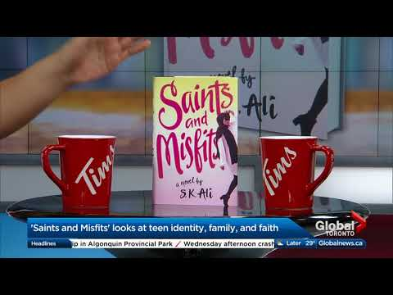
Saints and Misfits by S.K. Ali

Slide 5
Saints and Misfits
Themes
Coming of age
Navigating diverse identities
Teenage life
Sexual harassment
Confidence for girls
Positive and negative role models for boys and girls
School success
Plot and page-turner chapter format keep students reading
IMES Novel Guide
Six parts
Highlights accessible yet new vocabulary
Provides powerful critical thinking questions raised by the captivating storyline
Allows students to connect their own experience to the characters in the novel

Slide 6
Salt Houses by Hala Alyan
Author Reading at Politics and Prose (start at 3:57)

Slide 7
