Slide 1
Children’s & Young Adult Literature about Islam
and the Middle East
Dr. Noreen Naseem Rodríguez
Iowa State University

Slide 2
Lunch & Learn
Big Ideas:
Iowa Connections to Islam & the Middle East
The Danger of a Single Story
Books as Windows & Mirrors
BOOKS!!!
Intersectionality
Featured Texts about the Middle East
Featured Texas with Muslim Characters
Exploration Time

Slide 3
Iowa Connections to Islam & the Middle East

Slide 4
Iowa Muslims
From the Des Moines Register, 2016:
Estimates of the number of Muslims in Iowa range widely. The Council on American-Islamic Relations says there are 22 mosques in Iowa and roughly 50,000 Muslims. Officials at Cedar Rapids' Mother Mosque of North America say the number pushes 70,000, while a 2010 census by the Association of Religious Data Archives puts the figure at 1 percent of Iowa's 3.1 million population, or closer to 30,000.
The association's estimates show a 38 percent increase in the number of Muslims in Iowa from 2000 to 2010.
The highest concentrations are in Linn and Polk counties, where Muslims say their numbers continue to grow. In the past two years, mosques have opened in Waukee and on the south side of Des Moines, and another is scheduled to move into bigger quarters in the suburbs.
The growth is driven by increases in the immigrant population, especially when Bosnians came to Des Moines in the late 1990s, said Ako Abdul-Samad, perhaps Des Moines’ most visible Muslim as a state legislator and community leader.

Slide 5
POP QUIZ!
Iowa is home to a major place in
Muslim American history.

Slide 6
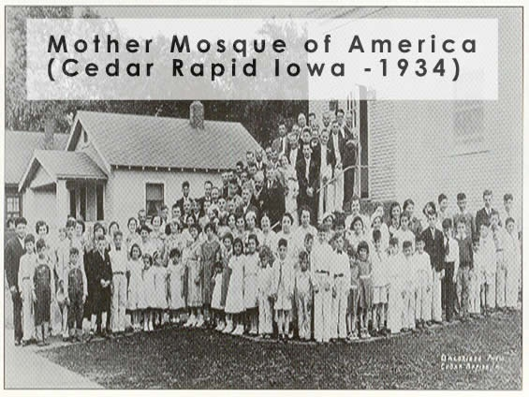

Slide 7
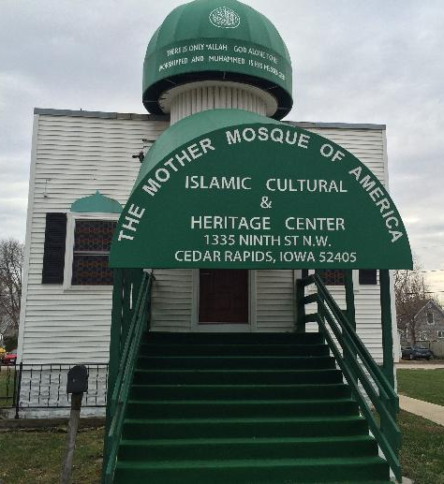
The Mother Mosque of America
Immigrants from the countries now known as Syria, Lebanon, Jordan, and Palestine (then classified as “Turks”) came to the United States in the 1870s in increasing flows until 1924; about 10% of these Arab immigrants settled in clusters across the Midwest.
In 1914, there were 45 Arab Muslims in Cedar Rapids; by the 1920s, the community grew and a group called “The Rose of Fraternity Lodge” rented a building to use as a house of worship. Plans were made to build a mosque at the beginning of the Great Depression, with most of the construction done by community members. The building opened its doors on February 15, 1934 and served as both a mosque and social center.
First building designed and constructed as a house of worship for Muslims in America (Al-Sadiq Mosque in Chicago was converted in 1922).
The Islamic Council of Iowa purchased the building in the 1990s and renovated it. It now serves as a mosque and information center and is the oldest surviving place of worship for Muslims in the United States.
Mother Mosque was added to the National Register of Historic Places in 1996

Slide 8
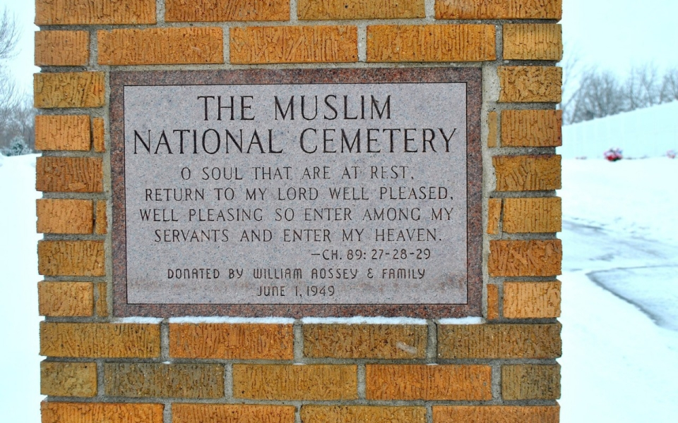
First Muslim Cemetery in the United States, Cedar Rapids, 1948

Slide 9
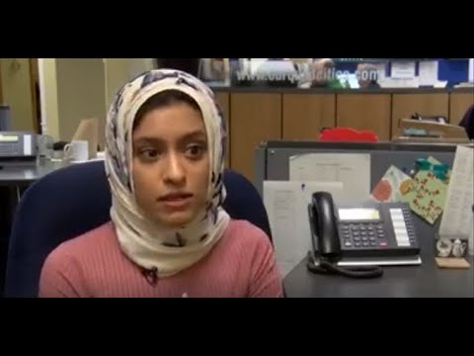
Tahera Rahman, WHBF Quad Cities

Slide 10
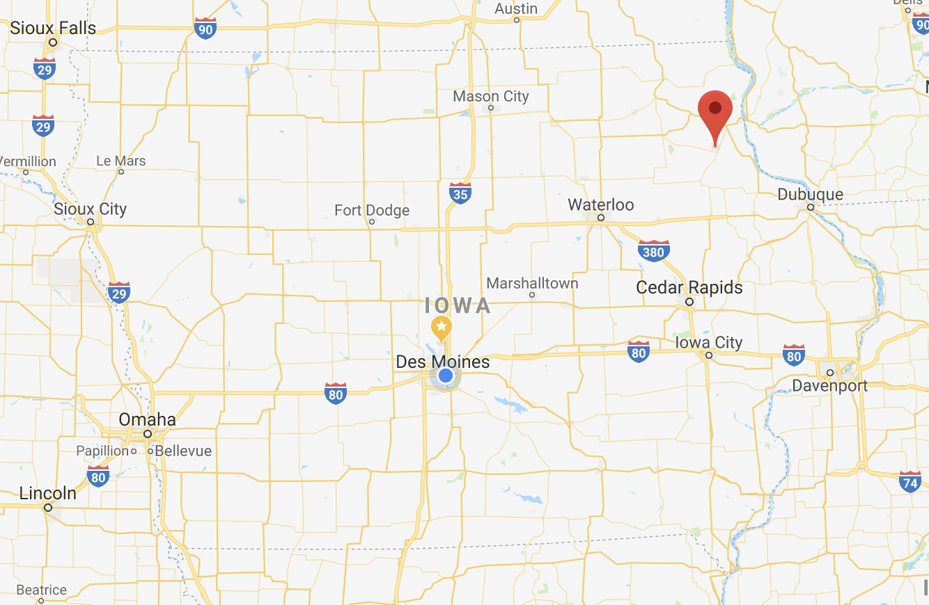
Elkader, Iowa
Notes:
https://www.nytimes.com/2013/05/04/us/iowa-town-named-for-muslim-hero-forges-world-ties.html

Slide 11
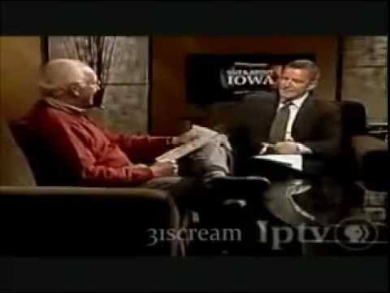
Elkader, Iowa
From the Abdelkader Education Project:
In the Missouri Territory of the United States, in 1846, Timothy Davis, a lawyer in Dubuque named a new settlement on the Turkey River, Elkader, in honor of the Emir. Thanks to accounts in the British press, we know that Davis admired the Abdelkader as a chivalrous "Arab Chieftain" who fought French colonial occupation for fourteen years. In 2008, it was in Elkader, Iowa that author, pig farmer, and historian John Kiser launched his book, Commander of the Faithful: The Life and Times of Emir Abdelkader, a story of True Jihad, inspiring the founding of the Abdelkader Education Project (AEP).

Slide 12
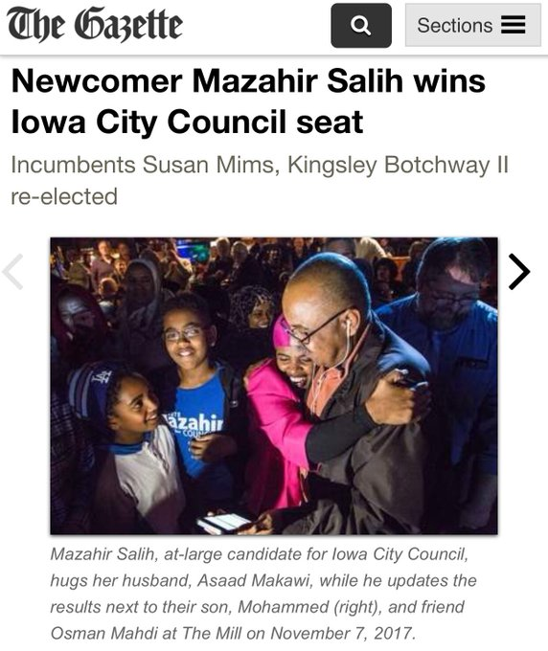
Mazahir Saleh, Iowa City Council

Slide 13
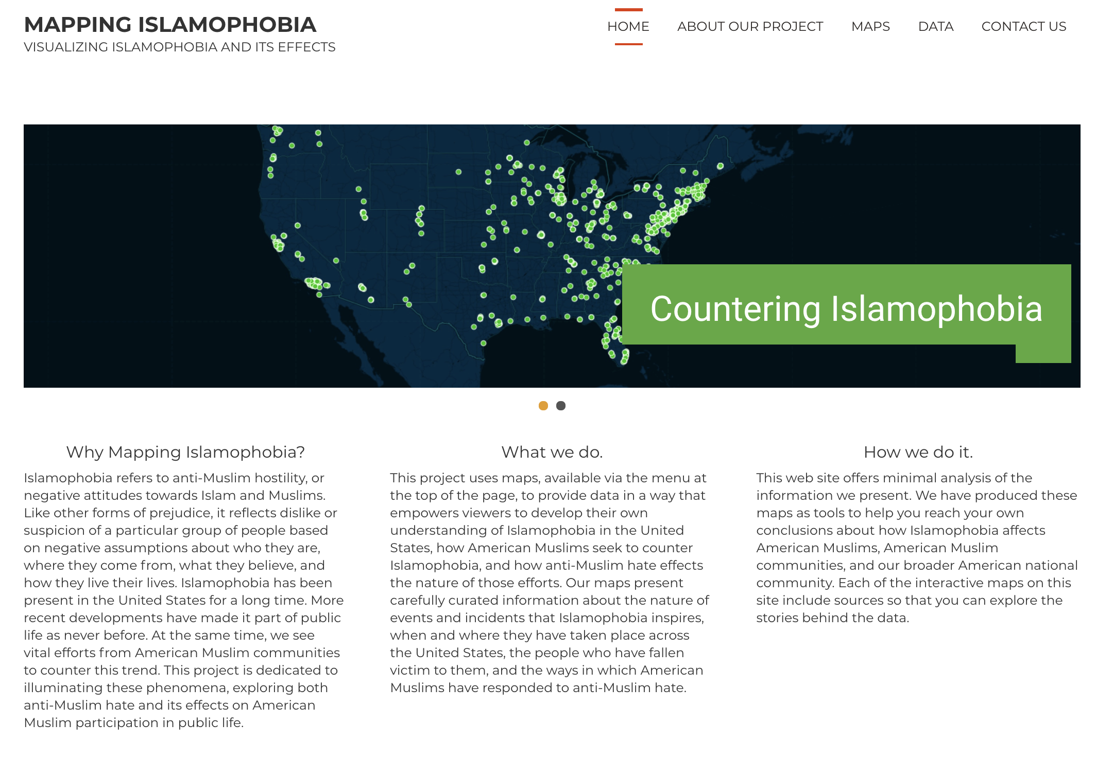
Notes:
Grinell College: Caleb Elfenbein

Slide 14
Single Stories about Islamophobia
and the Middle East

Slide 15
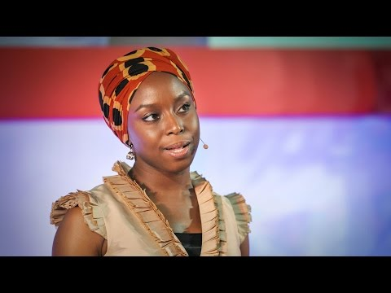
The Danger of
a Single Story
Chimamanda Ngozi Adichie

Slide 16
The single story creates stereotypes, and the problem with stereotypes is not that they are untrue, but that they are incomplete. They make one story become the only story.
CHIMAMANDA NGOZI ADICHIE

Slide 17
The Danger of a Single Story
So what is the danger of a single story?
How do single stories about Islam and the Middle East exist in schools?
In the media?
In popular culture?

Slide 18
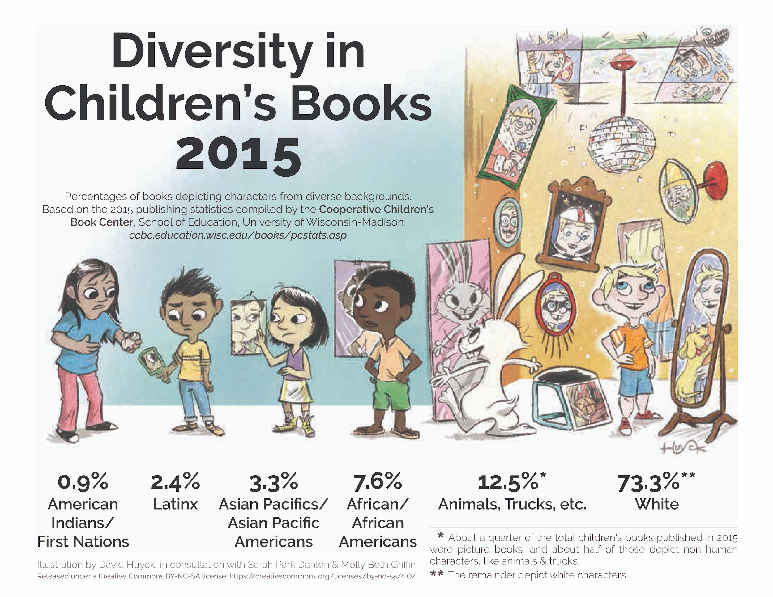

Slide 19
Notes:
For more info, visit the Children’s Cooperative Book Center website and We Need Diverse Books

Slide 20
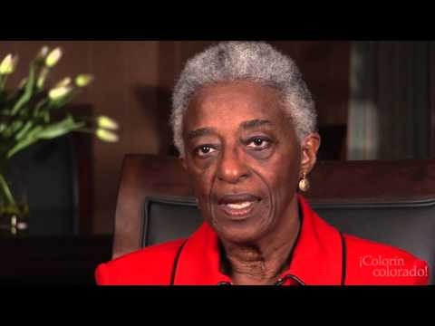
Books as Windows & Mirrors
Dr. Rudine Sims Bishop
1990

Slide 21
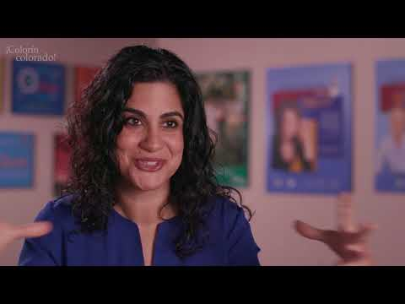
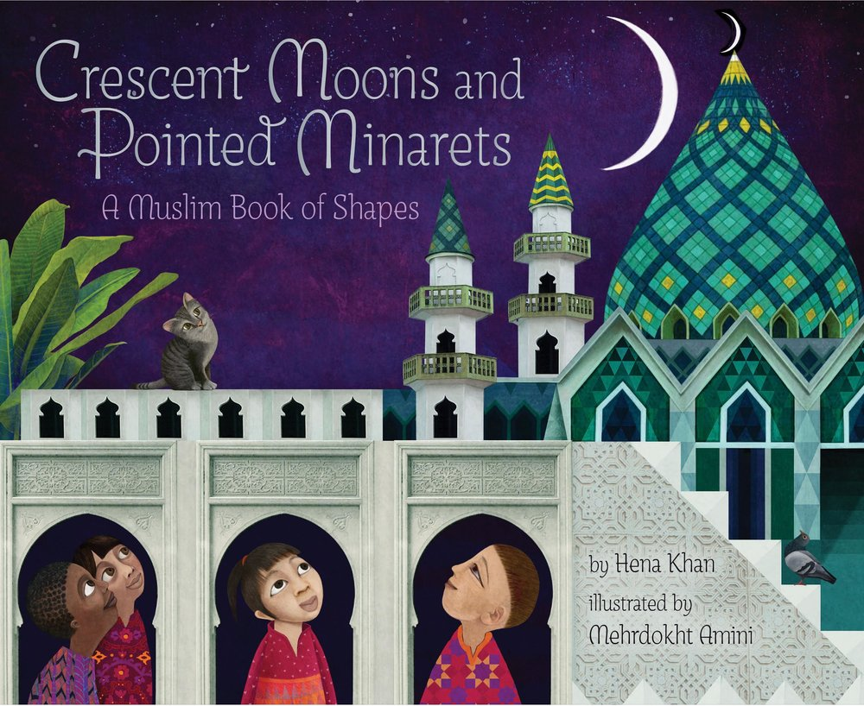
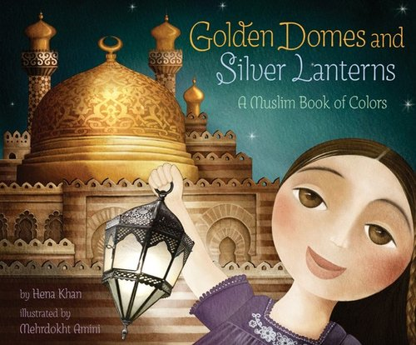
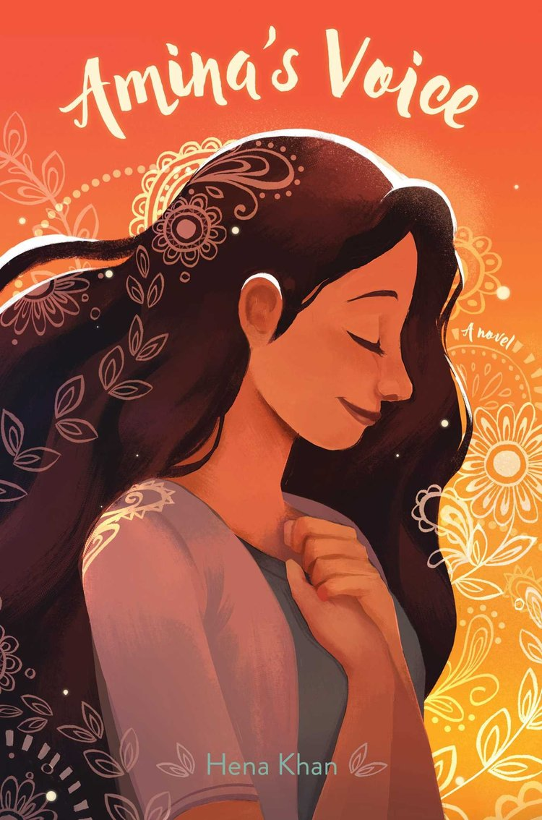
Hena Khan

Slide 22
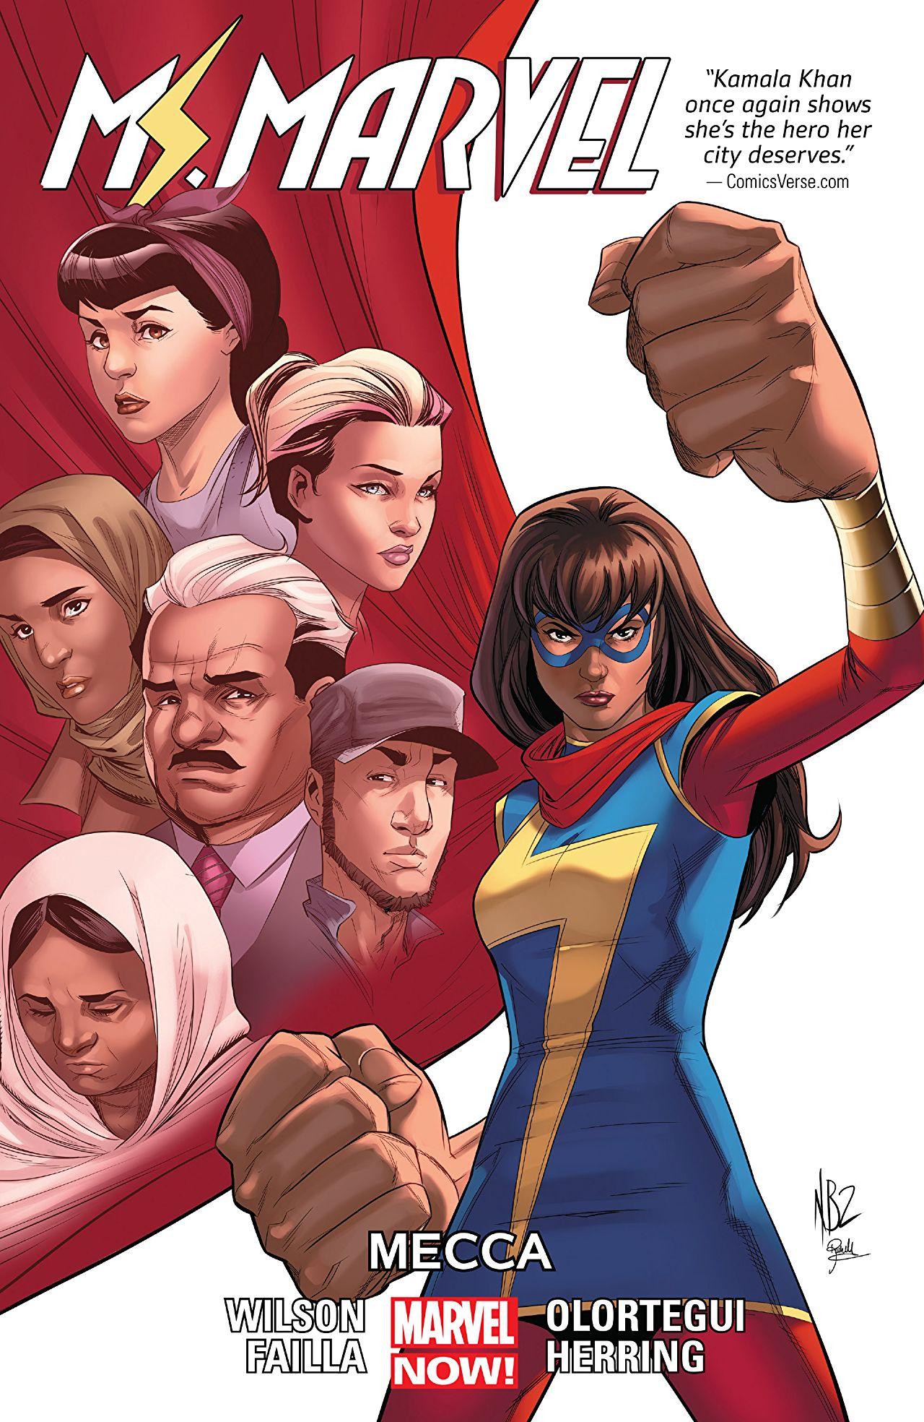

Slide 23
Guiding Questions for Text Selection
From whose perspective is the story told?
Whose voices and experiences are present/absent from the text?
What moral values and socio-political messages are dominant in the text?
How are cultural practices depicted?
What is the overall tone of the illustrations? The written narrative?
How are the lived experiences of marginalized populations represented in the text?
To what degree are complex social situations oversimplified in the text?
How are complex relationships between characters represented in the text?
Source: Children’s Literature Association - Diverse Literature Policy Statement

Slide 24
Guiding Questions for Student Engagement
How are you like ________ [character]? How are you not like ________ [character]?
How does this book make you feel?
[After selecting a particularly important spread in the book] If you could draw yourself anywhere in this picture, where would you be? What would you be doing? What would you be saying? How would you be feeling?
Whose voices are present in this book? Whose aren’t?
Whose experiences are represented? Whose aren’t?
How are the issues in this book relevant to you today? To your community? To others?
What does this book have to say about the world?
Source: Children’s Literature Association - Diverse Literature Policy Statement

Slide 25
Now the BOOKS!

Slide 26
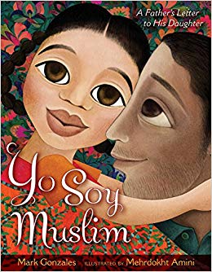
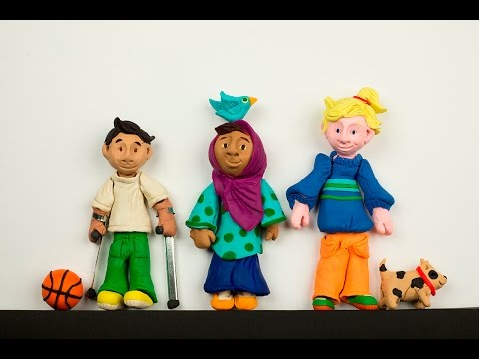
Intersectionality
Notes:
Between 55,000-198,000 Latinos practicing Islam in 2017; http://remezcla.com/lists/culture/comprehensive-study-latino-muslim-experience/
https://chicago.suntimes.com/news/latinos-converting-to-islam-chicago-elsewhere-spanish-religion/

Slide 27
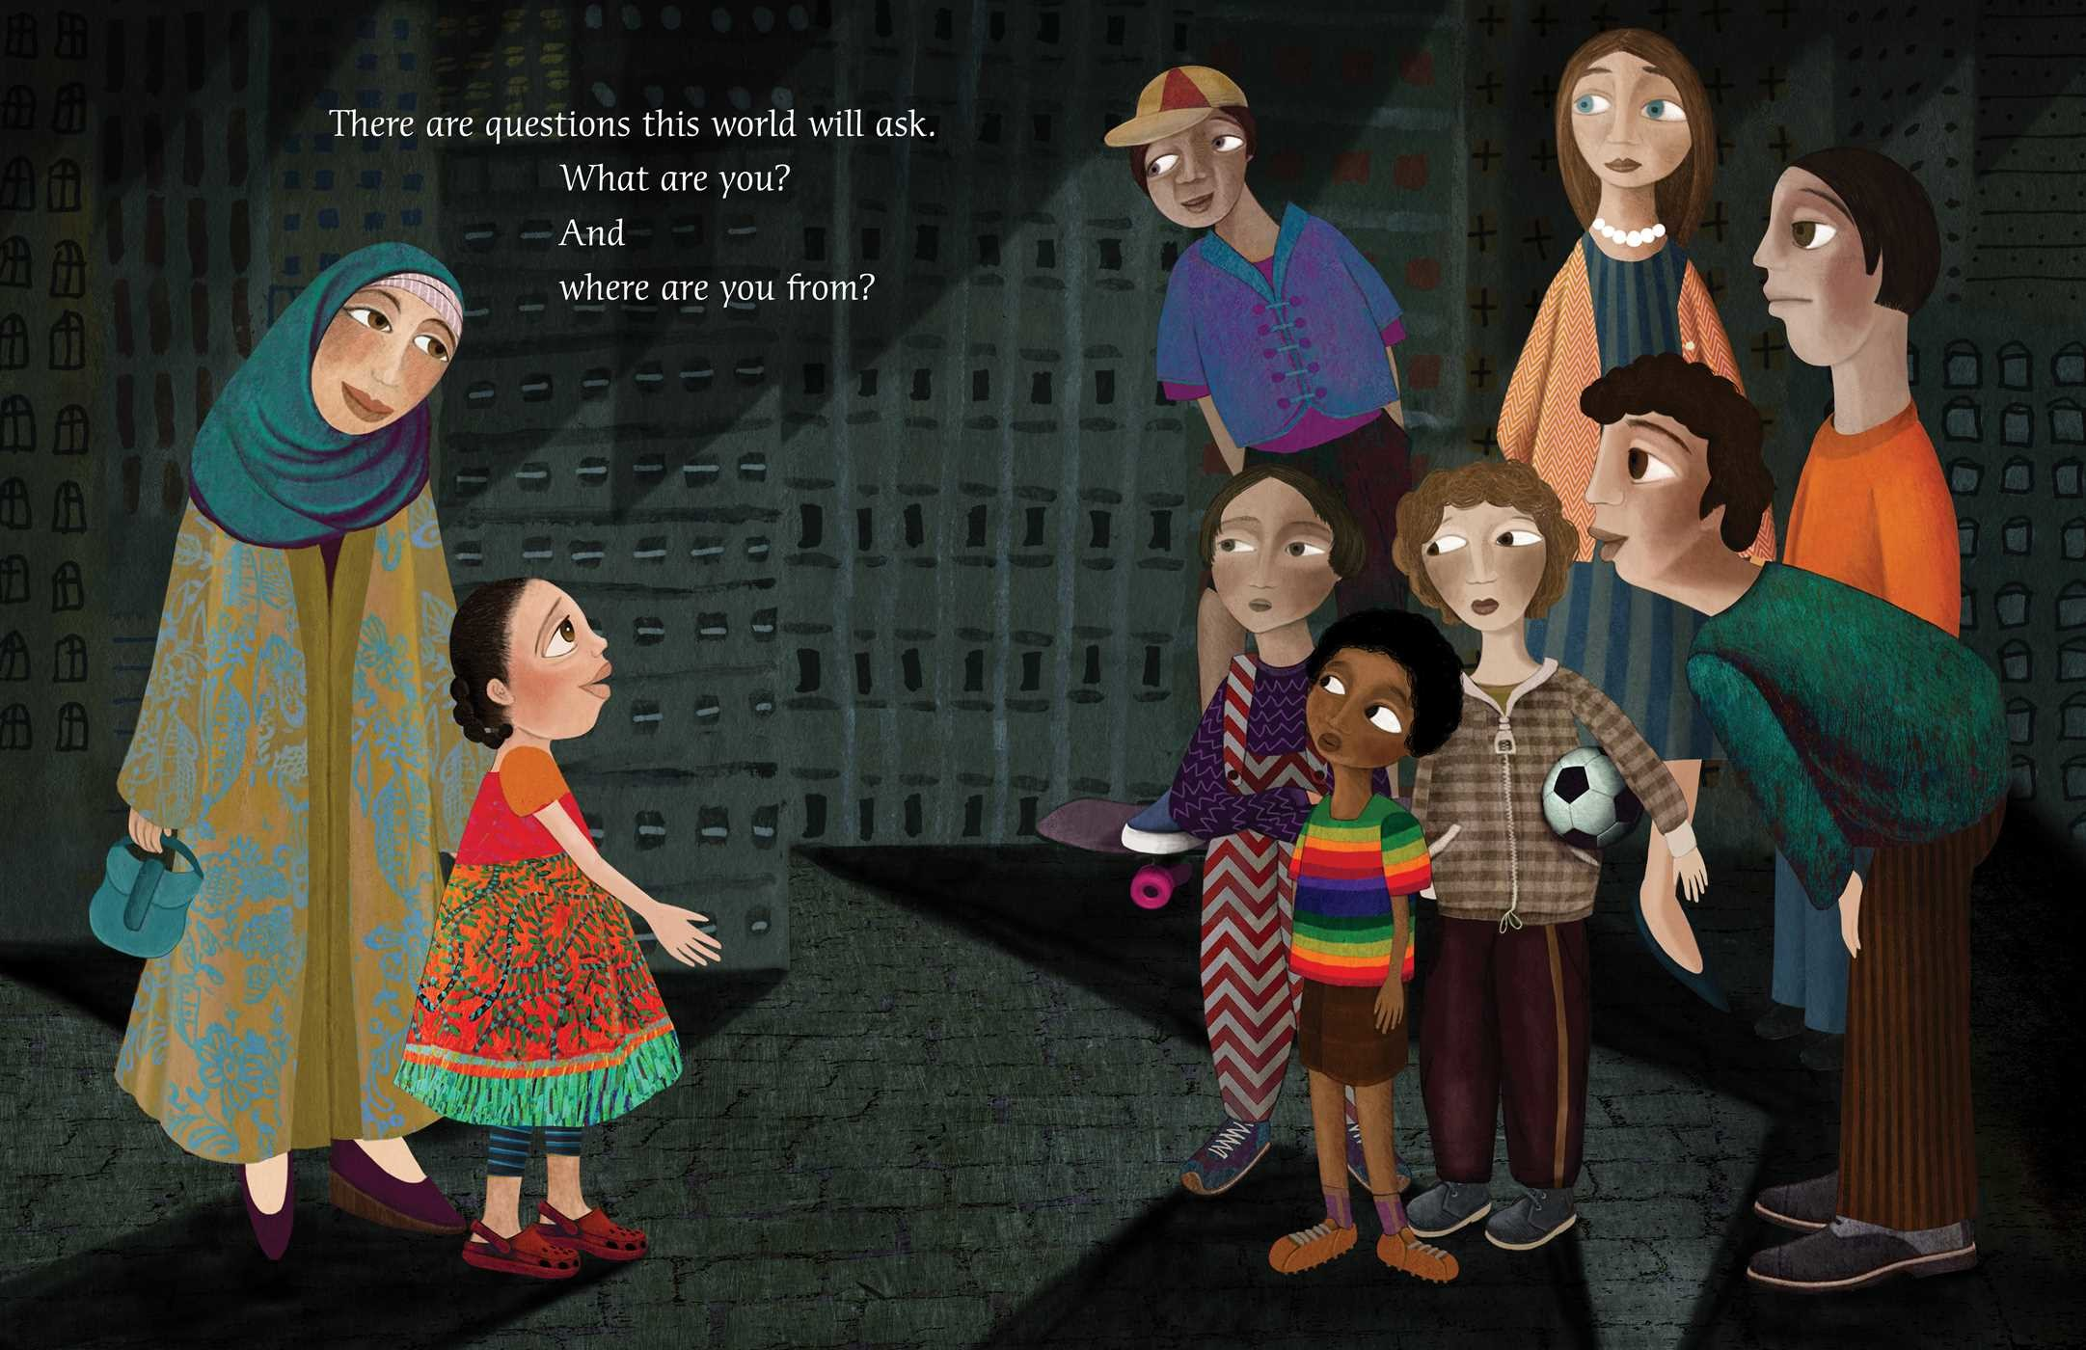

Slide 28
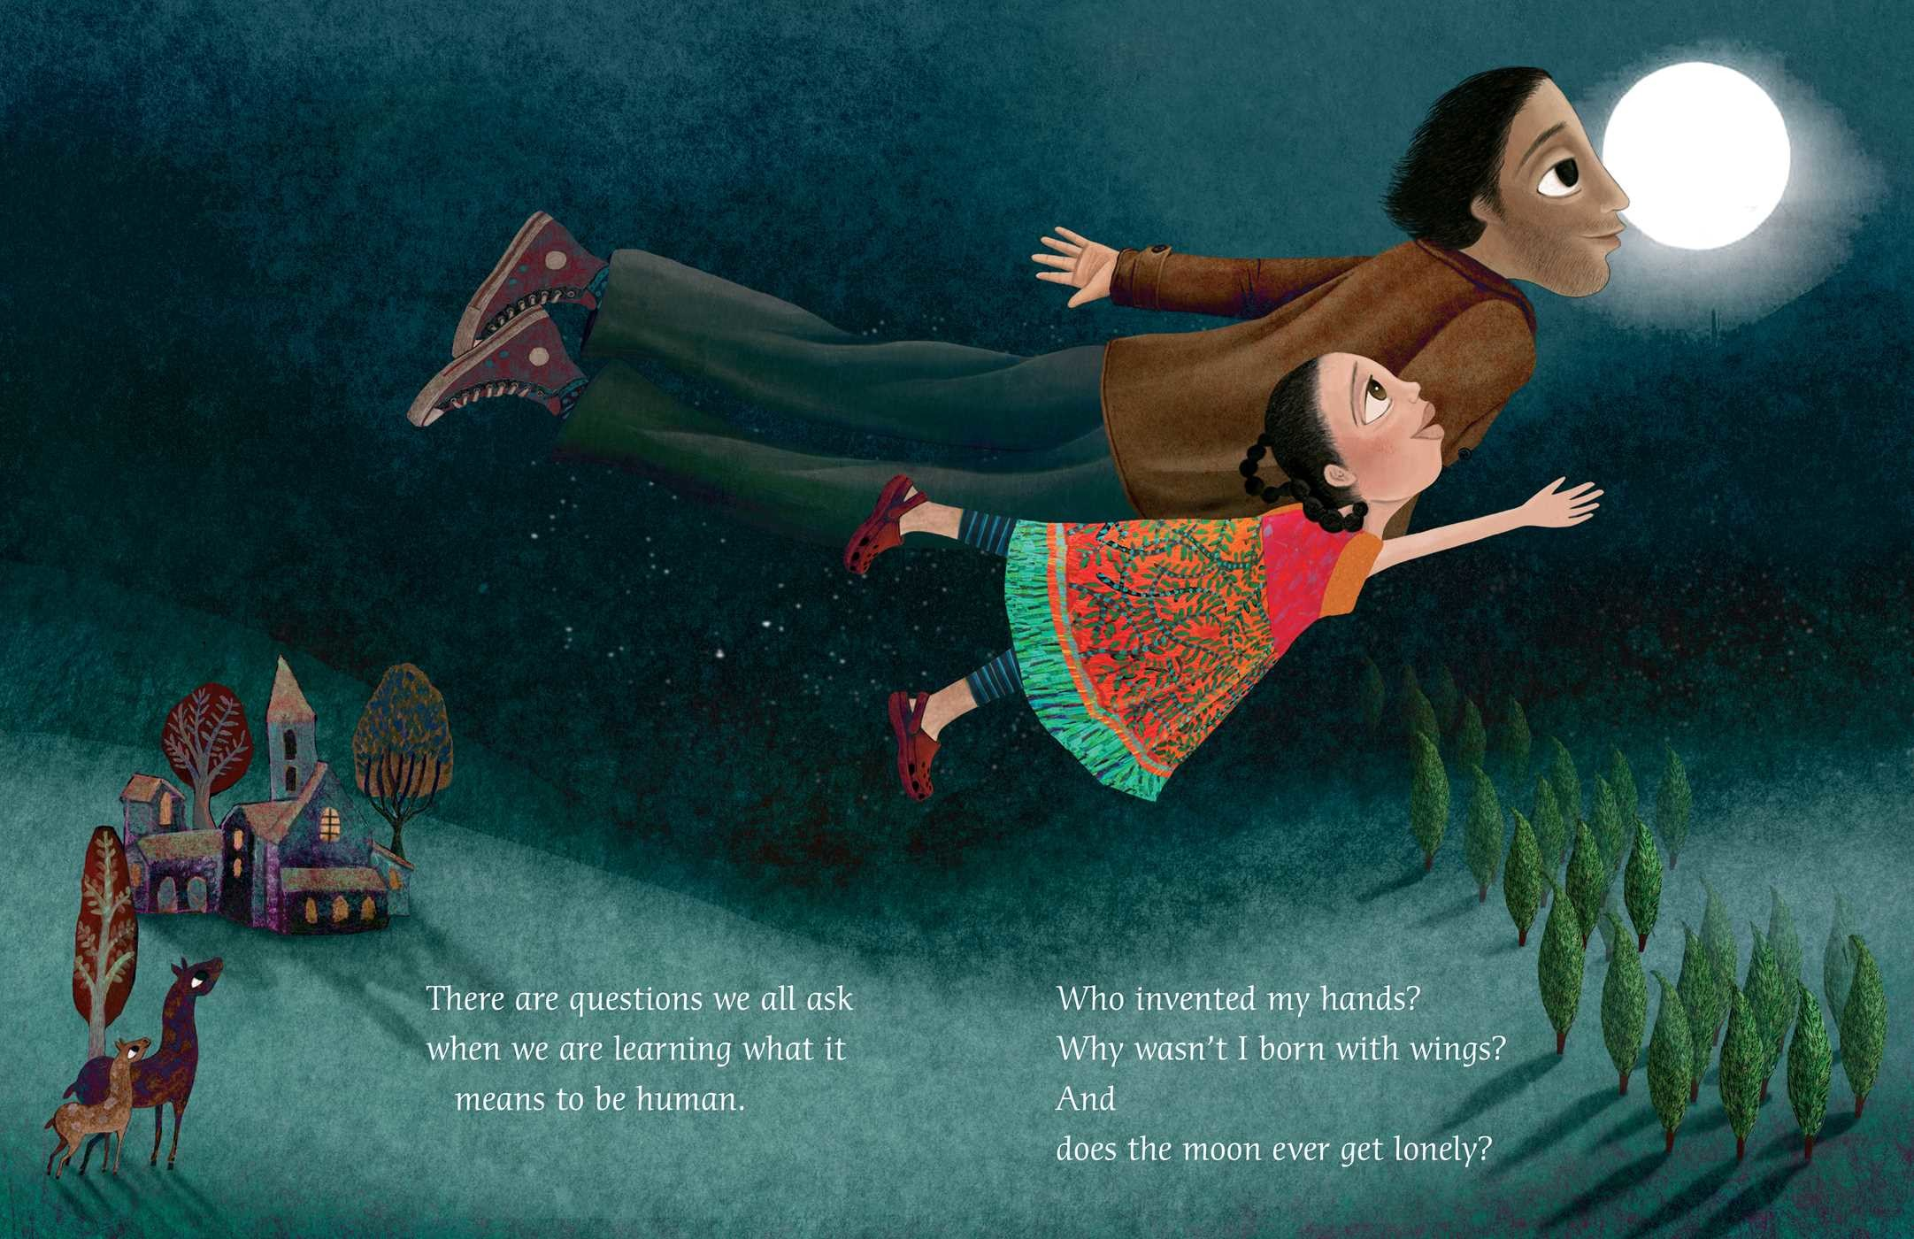

Slide 29
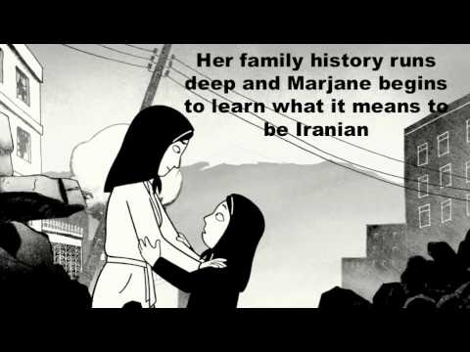
Persepolis by Marjane Satrapi

Slide 30
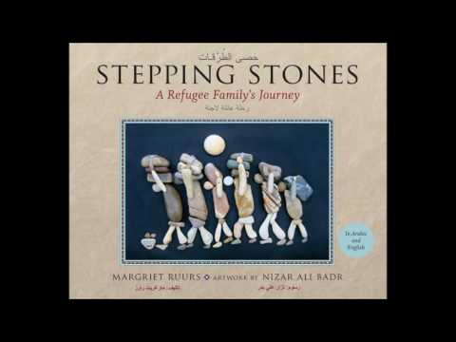
Stepping Stones: A Refugee Family’s Journey
by Margriet Ruurs & Nizar Ali Badr

Slide 31
Naomi Shihab Nye

Slide 32
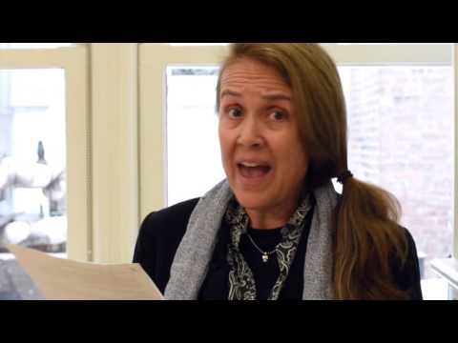
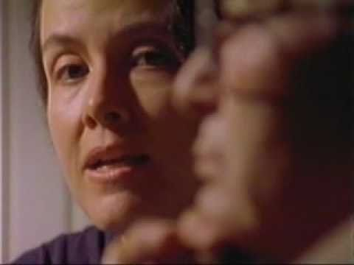
Naomi Shihab Nye
Notes:
https://gratefulness.org/resource/gate-4-a-immigration-hope-tears/
https://www.poetryfoundation.org/poems/48602/blood-56d229f9da8a9

Slide 33
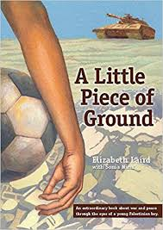
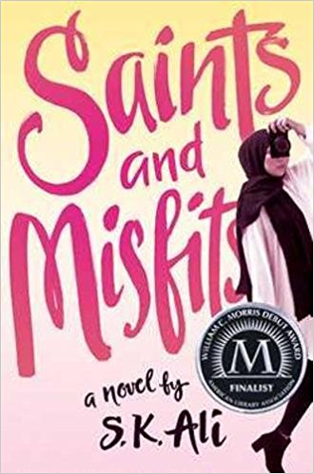

Slide 34
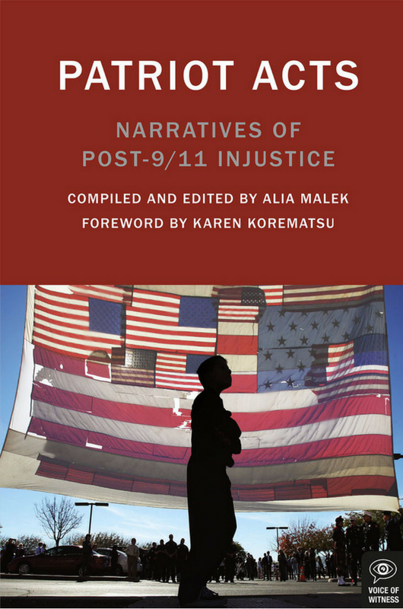
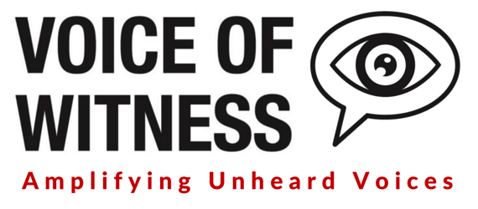
Excerpts from the text
Lesson plans

Slide 35
More Book Lists
Arabs & Arab Americans (Teaching for Change)
Muslims (Teaching for Change)
26 Books for Kids about the Arab World (Pragmatic Mom)
Arab American Book Award Winners (Arab American National Museum)
Books about Muslims or Middle Eastern Characters (Lee & Low Publishers)
NPR interview with Elizabeth Laird about the controversy behind A Little Piece of Ground

Slide 36
Muslim Publishers

Slide 37
https://tinyurl.com/MEkidYAlit
nrdz@iastate.edu

