Slide 1



Universal Design: Inclusivity in the Classroom
Majed Alsalem
King Saud University
Tuesday, Dec 13 - 2022

Slide 2





Part 1
Part 2
Part 3
Access to the general education curriculum
Designing different classroom environments based on UDL
Instructional design and activities through the UDL framework
UDL during the pandemic:
  synchronous
  asynchronous
Case study 1
Case study 2
Case study 3
Discussion
Historical Context
Theoretical Context
Legal Context
Educational Context
1
Universal Design: Inclusivity in the Classroom

Slide 3

Historical Context
2
Universal Design: Inclusivity in the Classroom

Slide 4
Technological
Cultural
Medical
Disability
Social
Educational
Harpur, P. (2012). Embracing the new disability rights paradigm: the importance of the convention on the rights of persons with disabilities. Disability & Society, 27(1), 1-14.
3
Universal Design: Inclusivity in the Classroom

Slide 5

Theoretical Context
4
Universal Design: Inclusivity in the Classroom

Slide 6

Practice
Theory
5
Universal Design: Inclusivity in the Classroom

Slide 7
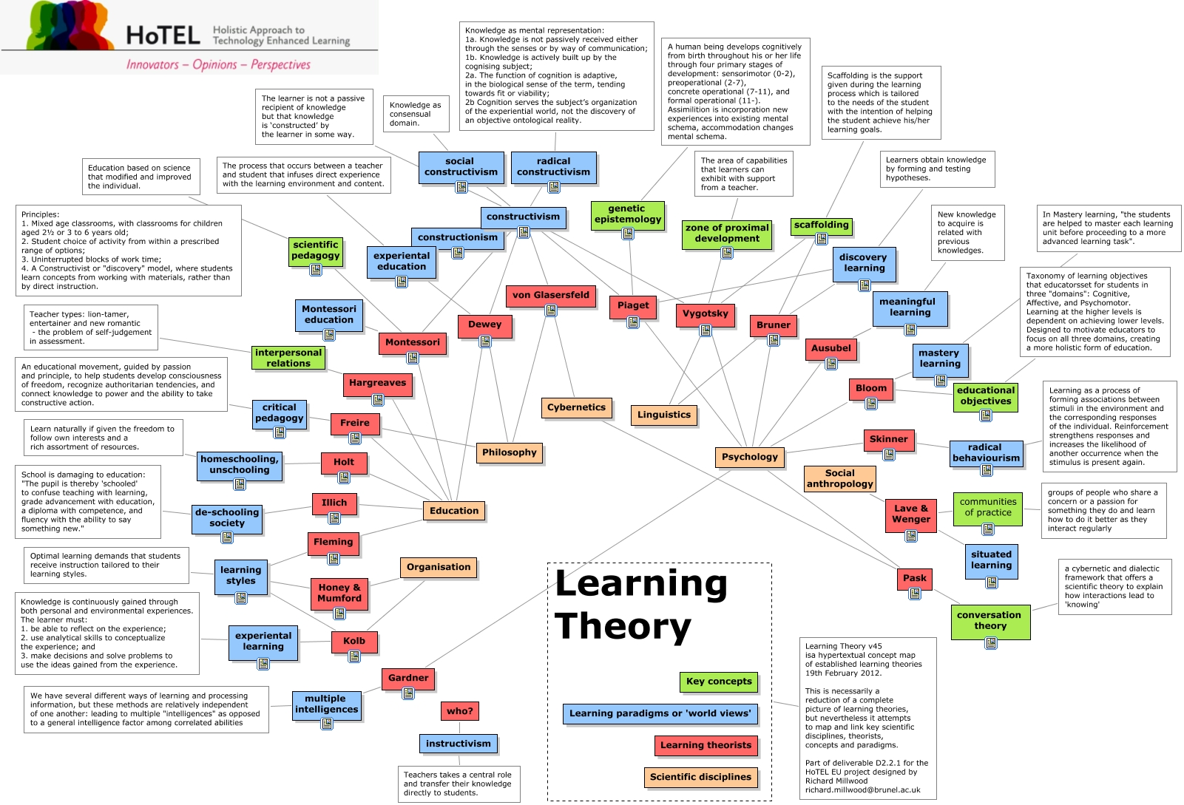
6
Universal Design: Inclusivity in the Classroom

Slide 8



Neuroscience
7
Universal Design: Inclusivity in the Classroom

Slide 9
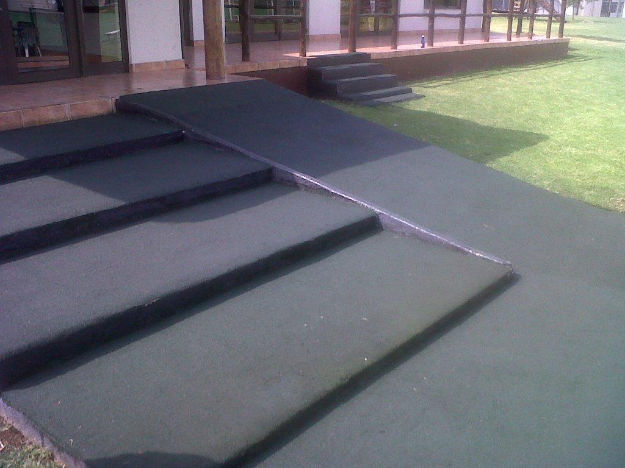
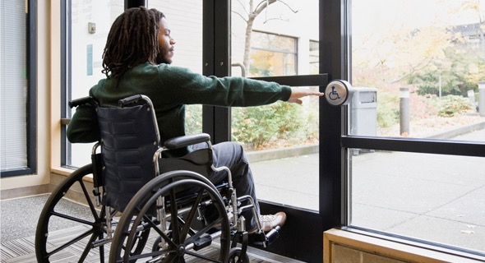
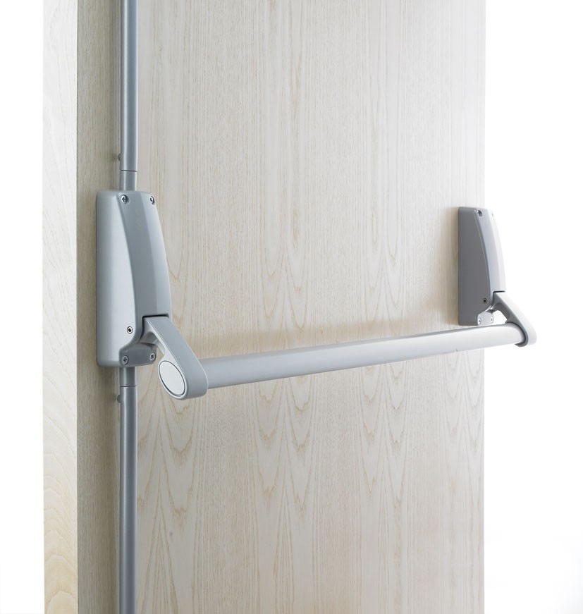
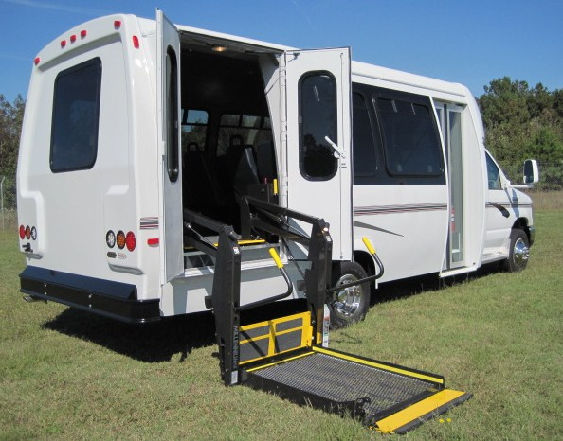
Universal Design
8
Universal Design: Inclusivity in the Classroom

Slide 10
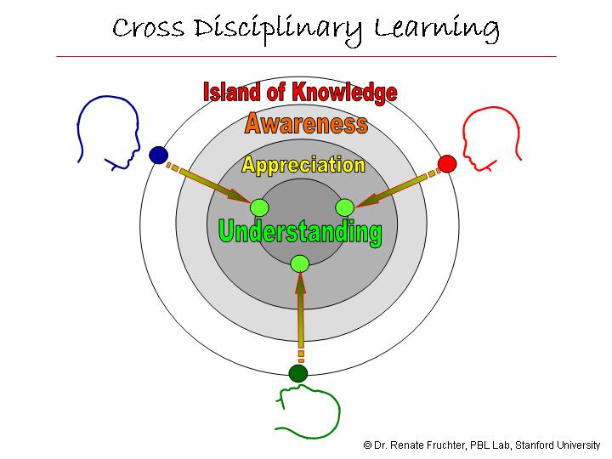
9
Universal Design: Inclusivity in the Classroom

Slide 11
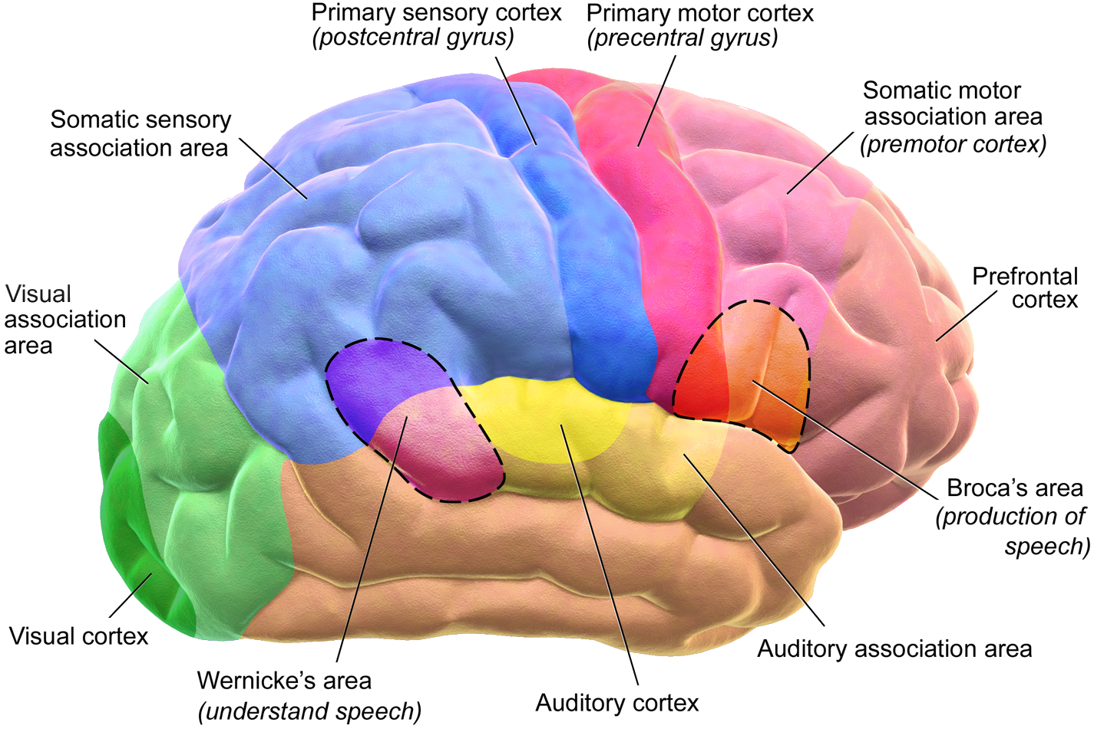
Brain functions during the learning process
10
Universal Design: Inclusivity in the Classroom

Slide 12
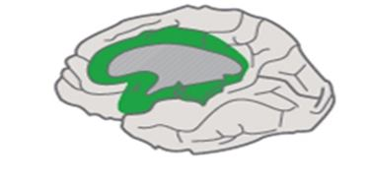
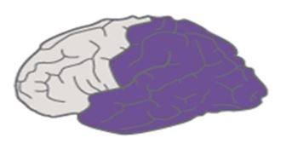
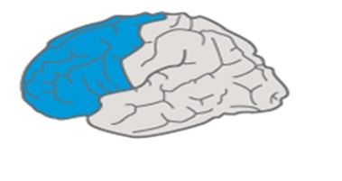
Universal Design for Learning
(UDL)
(Affective Networks)
(Recognition Networks)
(Strategic Networks)
11
Universal Design: Inclusivity in the Classroom

Slide 13
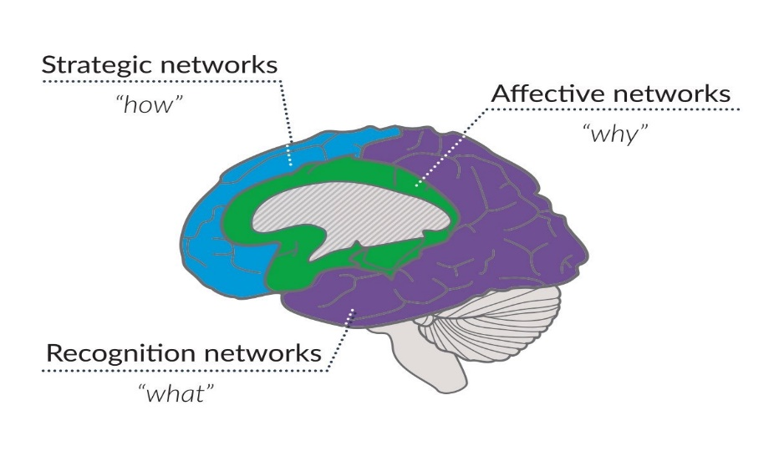
Brain functions during the learning process
Engagement
Action &
Expression
Representation
Universal Design for Learning is an educational framework that has three major principles:
Provide multiple means of Engagement
Provide multiple means of Representation
Provide multiple means of Action & Expression
UDL
(Rose & Meyer, 2002)
12
Universal Design: Inclusivity in the Classroom

Slide 14
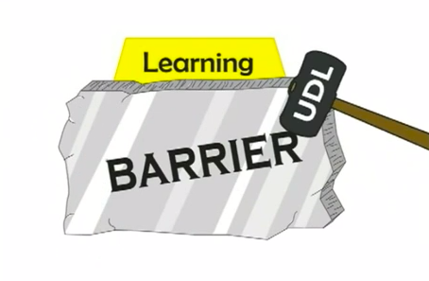

13
Universal Design: Inclusivity in the Classroom

Slide 15
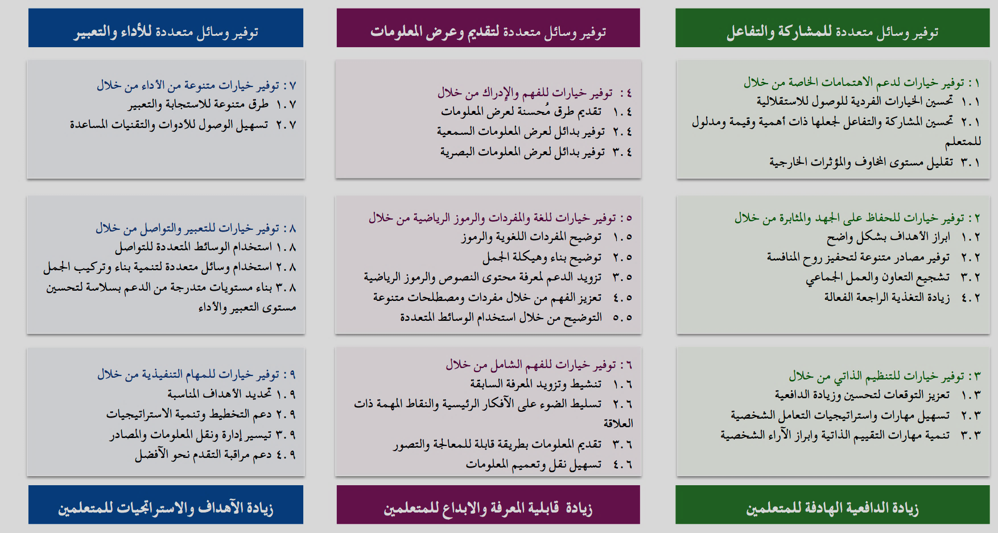
Principles of UDL
https://udlguidelines.cast.org/binaries/content/assets/udlguidelines/udlg-v2-0/udlg-graphicorganizer-v2-0-arabic.pdf
14
Universal Design: Inclusivity in the Classroom

Slide 16

Legal Context
15
Universal Design: Inclusivity in the Classroom

Slide 17

The Individuals with Disabilities Education Act
IDEA
Zero Reject.
Nondiscriminatory Identification and Evaluation
Free, Appropriate Public Education
Least Restrictive Environment
Due Process
Parent Participation
UDL
16
Universal Design: Inclusivity in the Classroom

Slide 18
Residential/
hospital schools
Special school/
institution
Least Restrictive Environment
Mainstream classroom
Resource room
General Classroom with support services
General Classroom
17
Universal Design: Inclusivity in the Classroom

Slide 19




Convention on the Rights of Persons with Disabilities
www.un.org/disabilities/documents/convention/convoptprot-a.pdf
https://www.un.org/disabilities/documents/convention/convoptprot-e.pdf
18
Universal Design: Inclusivity in the Classroom

Slide 20


Implementation
Macro Level
Ministry of education
Education Departments
Education Offices
School
Classroom
Micro Level
Student
19
Universal Design: Inclusivity in the Classroom

Slide 21
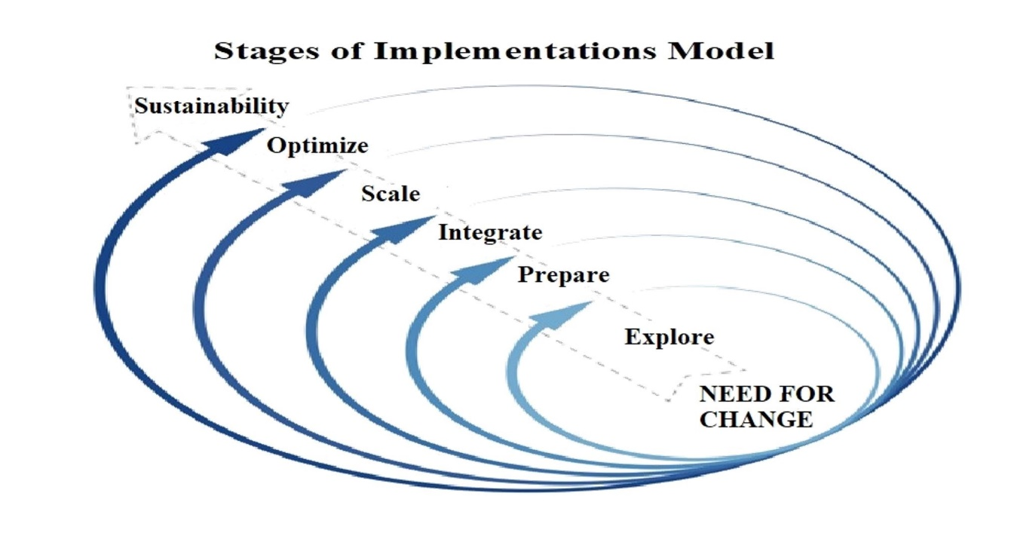
Implementation Model
Imp. Team
NO Imp. Team
Use of Implementation
Science And Practices
80%
3 Years
14%
17 Years
(Fixsen et al., 200) In search of program implementation…
20
Universal Design: Inclusivity in the Classroom

Slide 22


Educational Context
21
Universal Design: Inclusivity in the Classroom

Slide 23

Educational Process
Objectives
Adaptation
Content/
Material
Assessment
Educational
Tools
Educational
Activities
22
Universal Design: Inclusivity in the Classroom

Slide 24

Supporting students with disabilities
Personal Support
Curriculum Accommodations and Adaptations
Technical Support
Materials Adaptations
Instructional Design Adaptations
Assistive technologies & Digital Content
Adaptations related to the educational environment (classroom)
Adaptations for Individual
(Individualized Education Plan)
Adaptations for group
23
Universal Design: Inclusivity in the Classroom

Slide 25
Curriculum Accommodations and Adaptations Levels
Output | Methods of Instruction | Content | Goals | Types of Modification
Similar to GEC | Modified | Similar to GEC | Similar to GEC | Accommodation
Modified | Modified | Similar to GEC | Slightly modified | Adaptation
Modified | Modified | Similar to GEC | Significantly modified | Parallel Curriculum
Modified | Different | Different | Different | Overlapping
(Hall at al., 2004) Curriculum Modification
24
Universal Design: Inclusivity in the Classroom

Slide 26
Curriculum Accommodations and Adaptations
Input
Quantity
Time
Level of Support
Degree of Participation
Difficulty
Output
Alternative Goals
Alternative Curriculum
25
Universal Design: Inclusivity in the Classroom

Slide 27
Part 2
Deep look to UDL
https://www.youtube.com/watch?v=uGAuD3nndSk&list=PPSV
26
Universal Design: Inclusivity in the Classroom

Slide 28

Stages of Preparing Textbook
Preparing the Curriculum Document
Authorship Committees
Curriculum Plan
Structure of the textbook
Preparing a Sample Unit
Building Units Based on UDL
Language Editing and Design
Transforming textbook into digital content
27
Universal Design: Inclusivity in the Classroom

Slide 29
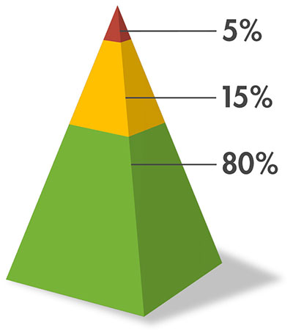
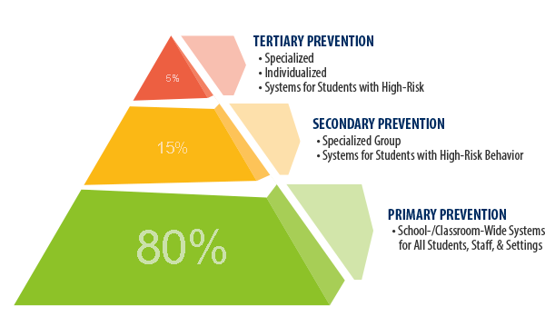
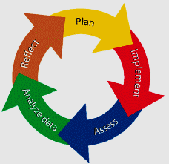






Data driven decision making
Response to Intervention
Positive Behavior Support
Evidence Based Practice
Curriculum Accommodations & Adaptations
Applied Behavior Analysis
Assistive Technology
28
Universal Design: Inclusivity in the Classroom

Slide 30
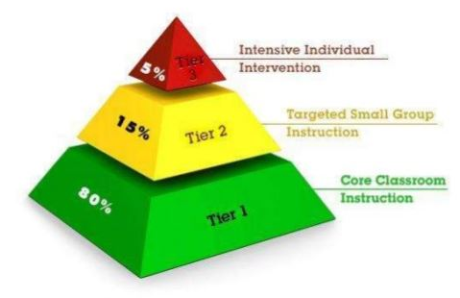
RTI & UDL
Intensive
Intervention
1-5%
Tier 3
Tier 2
Intervention
5-10%
Tier 1
UDL
80-90%
At risk students
29
Universal Design: Inclusivity in the Classroom

Slide 31
Common Mistakes About UDL
UDL is based on technology only.
UDL for students with disabilities only.
UDL is a teaching method.
UDL for a specific teaching topic or content.
UDL for a small group of students.
UDL for special education teachers.
UDL is not based on scientific research.
(Nelson & Basham, 2014)
30
Universal Design: Inclusivity in the Classroom

Slide 32









Evidence-based Practice
Context and Setting
Participants
Intervention
Description
Of
Practice
Outcome
Internal
Validity
Data
Analysis
Implementation
Fidelity
(CEC, 2014)
31
Universal Design: Inclusivity in the Classroom

Slide 33

Part 3
Case study 1
Case study 2
Case study 3
32
Universal Design: Inclusivity in the Classroom

Slide 34

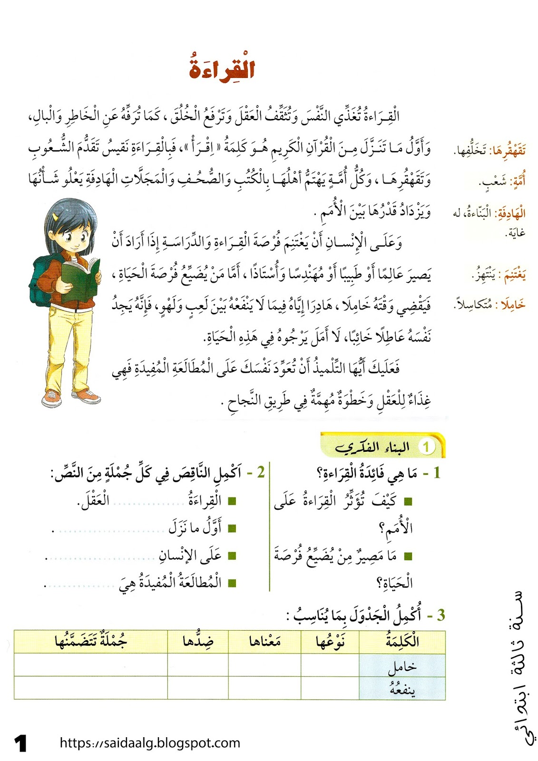

Case Study 1
33
Universal Design: Inclusivity in the Classroom

Slide 35
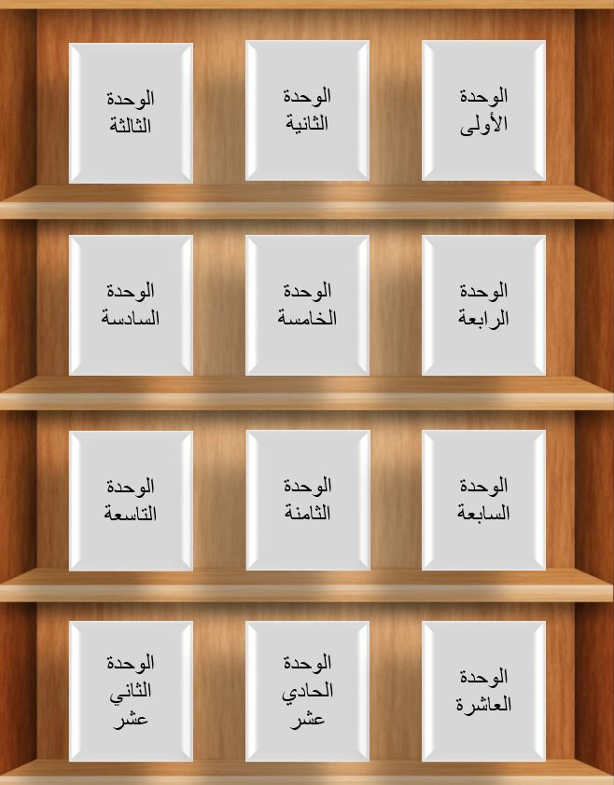



Book Chapters
Digital Book
Brief Presentation (Sign Language / Vocal)
34
Universal Design: Inclusivity in the Classroom

Slide 36
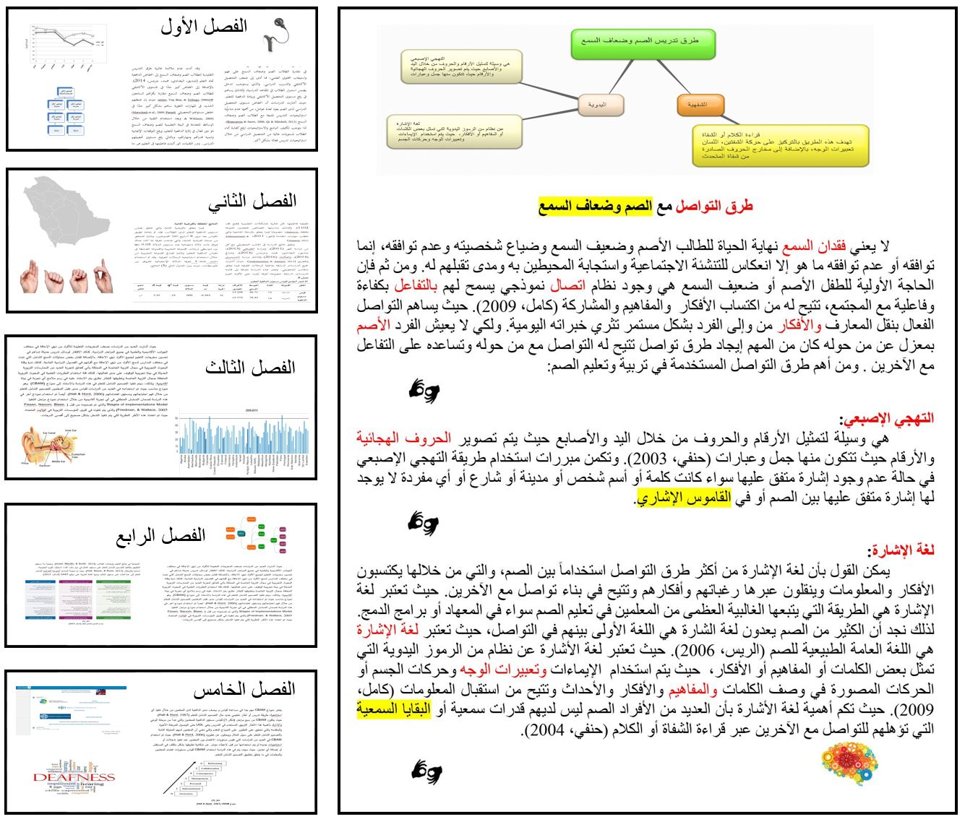
Concept Map
When student clicks on the words in red, it goes to glossary
This option allows the student to translate written texts into sign language or vocal
Book Units
When student clicks on highlighted words, a picture or a video appears to explain the meaning
This option provides metacognitive strategies
35
Universal Design: Inclusivity in the Classroom

Slide 37
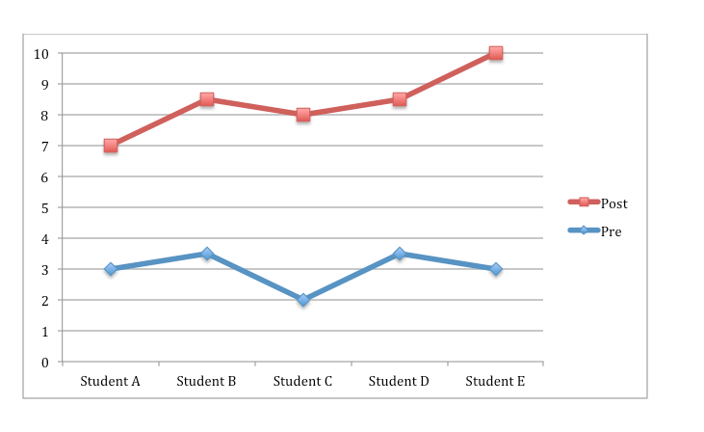
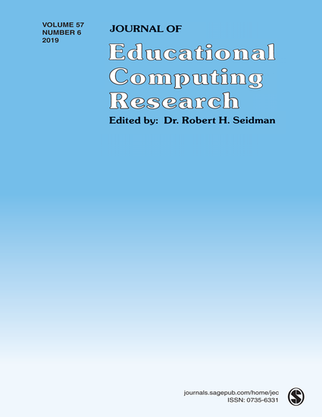
Exploring Metacognitive Strategies Utilizing Digital Books: Enhancing Reading Comprehension Among Deaf and Hard of Hearing Students in Saudi Arabian Higher Education Settings
Impact Factor: 4.345
36
Universal Design: Inclusivity in the Classroom

Slide 38
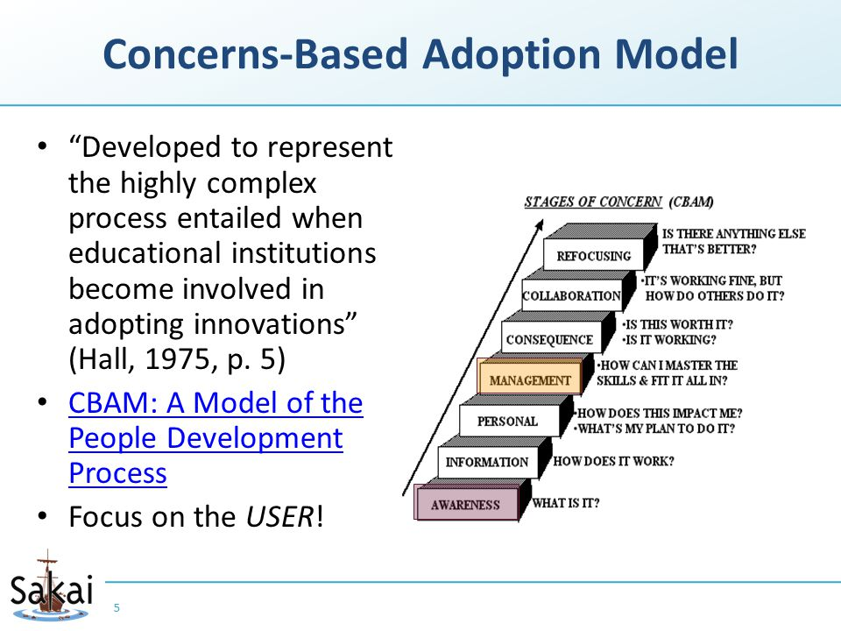
Case Study 2
Special Education Teachers
1st Stage:
2nd Stage:
3rd Stage:
37
Universal Design: Inclusivity in the Classroom

Slide 39
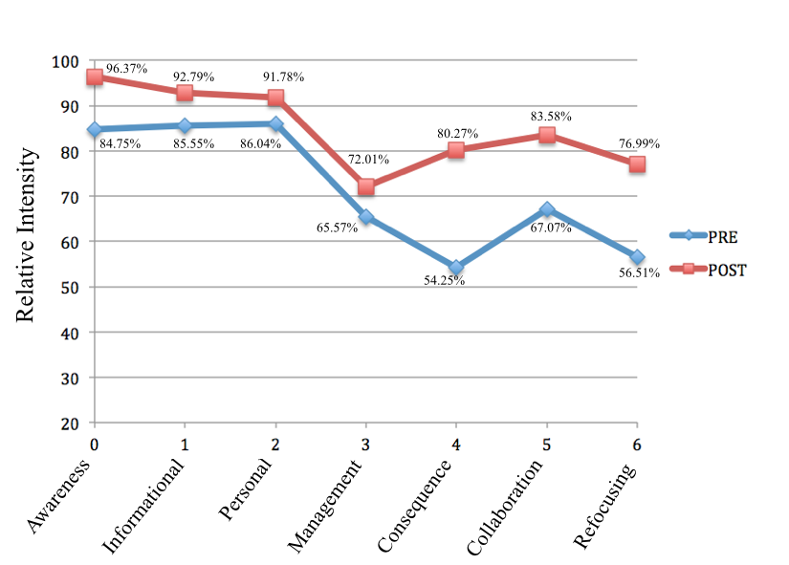
Special Education Teachers
38
Universal Design: Inclusivity in the Classroom

Slide 40




Handbook to Access Students with Disabilities to the General Education Curricula
39
Universal Design: Inclusivity in the Classroom

Slide 41

Discussion
Universal Design: Inclusivity in the Classroom

Slide 42

majalsalem@ksu.edu.sa
@majalsalem
Universal Design: Inclusivity in the Classroom

