Slide 1
Using Science Books/Stories to Promote Arabic Language Learning: An Interdisciplinary Approach
How Inquiry and Meaning Drive Heritage Language Growth
Aya Isaac PhD Candidate, University at Albany, SUNY ALEF Forum 2025

Slide 2
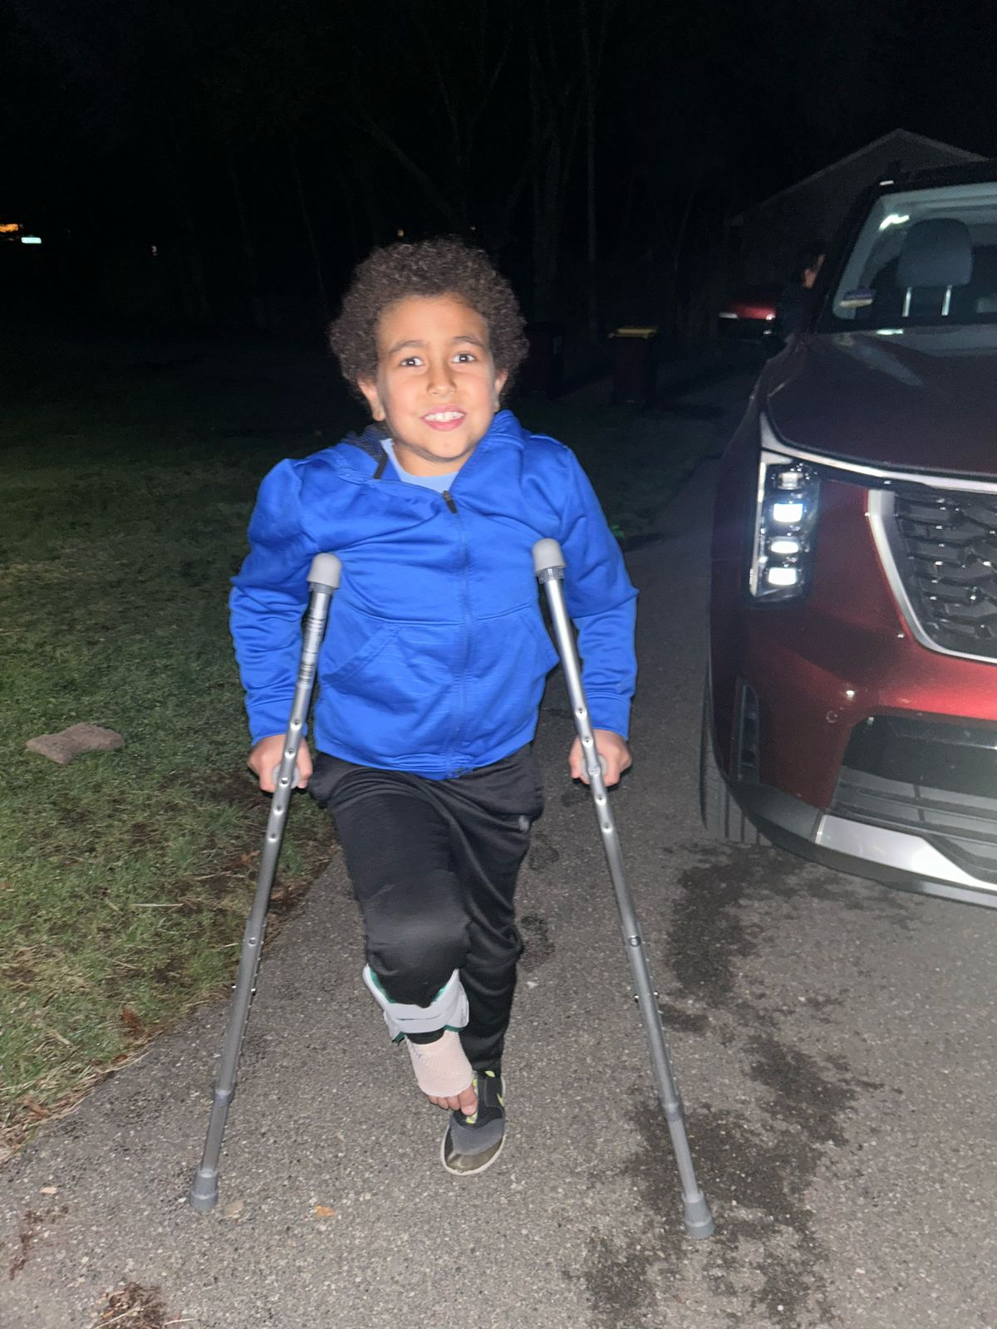
كويس الحمد لله!
كويس الحمد لله!
عملت إيه مع أصحابك؟
عامل إيه انهردة؟

Slide 3
كويس الحمد لله!
كويس الحمد لله!
عملت إيه مع أصحابك؟
عامل إيه انهردة؟

Slide 4
How Kids Decode a language?
Children don’t learn language in isolation—they decode it through context, meaning, and use.
“The brain looks for patterns, not flashcards.”
🔍 They observe body language, visuals, tone
🧩 They guess using context and familiar patterns
🎯 They test saying words, adjusting based on feedback
📚 They connect words to real-life experiences (especially in stories or tasks)

Slide 5
Strategies for growth
What Are We Missing in Arabic Language Learning?
Arabic learners often memorize vocabulary without real-life use or context clues.
They’re not given chances to observe, guess, or test language through inquiry.
Science and other content areas are rarely used as tools to connect meaningfully with Arabic.
As a result, learners aren’t using Arabic to think, wonder, or build understanding—just to recall.
Navigating the future

Slide 6
Theoretical Lens – What is the Foundation for this research?
Interdisciplinary Language & Content Instruction: Language learning is deeper when content matters.
Sociocultural Theory (Vygotsky): Learning is meaningful when tied to social context and tools.
Inquiry-Based Learning (IBL): Knowledge grows through curiosity and exploration.
“Learners connect best with what’s real and purposeful.”

Slide 7
Arabic Book Club – Science Facts!
Research Question: What roles do STEM-themed storybooks play in enhancing Arabic language proficiency among heritage learners, and how can they support meaningful learning experiences?
Participants: 12 Arabic heritage learners (ages 7–12) in a weekend community program
Setting: Volunteer-led classroom near Albany, NY
Approach: 10-week study using STEM storybooks + task-based, inquiry-driven activities
Data Sources:Observation notesLearner artifacts (reflections, stories, presentations)Student interviews
Operating margins have improved, signaling operational efficiency, while strengthening our reserves.
This underscores our commitment to financial stability, positioning us for sustained growth.

Slide 8
Strategies for growth
What I Found – Key Themes from the Classroom
Learner Engagement
STEM books sparked high interest due to visuals and real-world connections
Students preferred stories that aligned with personal interests or prior science knowledge
Vocabulary Development
Students used contextual guessing or glossaries to learn new terms
Visuals helped learners infer meanings (e.g., Antartika, Sharnaka)
Dialectal mismatch sometimes limit real-life usage
Interpretive Communication Growth
ACTFL’s “Interpretive” standard was key: students could decode meaning even without explicit instruction
Navigating the future

Slide 9
Sample Lesson
Lesson Format : Rotating structures of reading, listening, hands-on creation, and presenting
Example 1: Solar System Book | Vocabulary: كوكب، مدار، جاذبية، قمر Activity: Students built models and presented using new terms Reflection: "I used جاذبية when explaining how Earth holds us."
Example 2: STEM Story & Artifact Writing | Read a story about bees → built a bee habitat → wrote a short story in Arabic Students personalized vocabulary and shared original ideas using the target words

Slide 10
How can we Design with purpose?
Know Your Learner
Define the Goal
What language skill(s) are you targeting? (e.g., vocabulary, presentation, comprehension)
Backward plan: What should the learner be able to do by the end?
Make it Real
Break the goal into smaller, hands-on experiences
Use storybooks not just as texts, but as stakeholders—tools that spark curiosity and drive inquiry
Create Immersive Experiences
Anchor learning in real-life scenarios
Assess their Arabic proficiency
Understand their interests and what feels meaningful to them
Encourage learners to read, ask, build, share, and reflect—in Arabic
“The storybook is not the goal. It’s a bridge to something meaningful.”

Slide 11
How can we plan the Resources?
Choose Arabic science books with engaging visuals and simple explanations
Center inquiry: Start with a question students can explore
Connect with life: Encourage students to build, draw, or simulate
Revisit vocabulary in context, not isolation
💡 Tip: Don't just "teach the words" — let the book and activity do the work.

Slide 12
Strategies for growth
Why Does it Matter?- References
Motivation & Engagement
Vocabulary Acquisition through Context
Learners retained more vocabulary when supported by visuals, hands-on tasks, and contextual guessing. 📖 İnal & Çakır (2014): Story-based learning improves vocabulary retention. 📖 Kuhn & Stahl (1998): Repeated exposure in meaningful contexts supports long-term mastery.
Language Use for Meaning
Culturally Responsive Pedagogy
STEM stories increased intrinsic motivation by connecting with learners’ interests and prior knowledge. 📖 Sya’diah et al. (2024): Motivation in language learning is fueled by relevant, engaging materials. 📖 Schiefer et al. (2024): Interdisciplinary teaching boosts motivation in heritage learners through cultural and academic alignment.
The integration of science and language allowed students to use Arabic to explain, present, and wonder. 📖 Ellis (2000): Task-based language learning encourages meaningful use and deeper cognitive engagement.
Learners connected more deeply when books reflected both scientific themes and cultural values 📖 Lanier Temples (2013): Identity and investment drive heritage learner engagement. 📖 Rozhenkova (2016): Curriculum design must align with heritage learners' lived realities.
Navigating the future

Slide 13
How can we plan the Resources?
“Science books are more real and easier to understand.”
“I understand the picture... it makes the words easier”
“I like stories without too many bubbles. I want a clear text I can follow.”

Slide 14
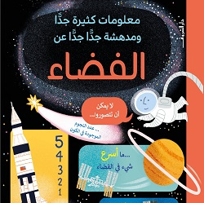
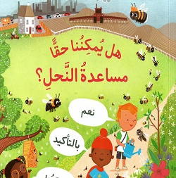
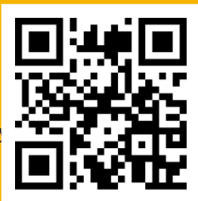
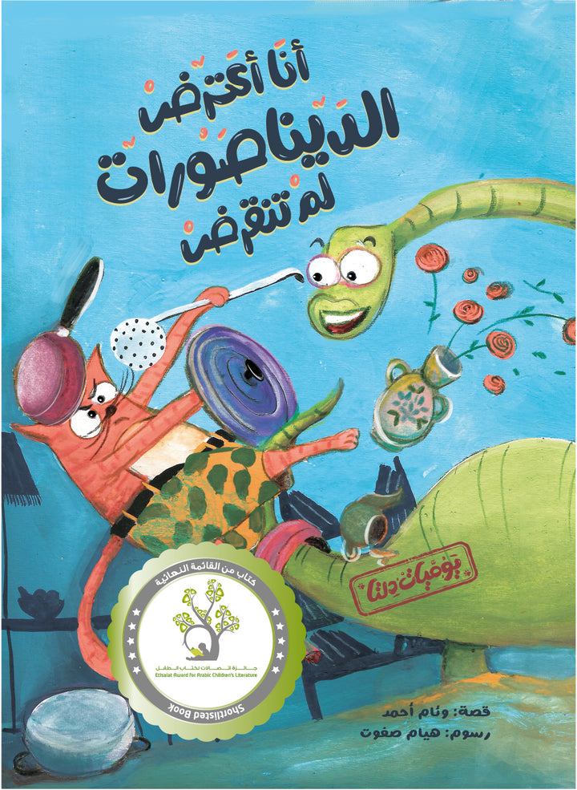
Till we meet for the next Book! Shukran!
ayais@umich.edu
+1-5189770663

