Slide 1
Colloquial Engagement Theory with AI Awareness Framework (CET-AIA)
Chokri Kooli
Richmond, USA
02/05/2025

Slide 2
CET-AIA Framework for Ethical AI in Language Assessment
Introduction to CET-AIA Framework
Research Objective & Scope
Literature Gaps and Theoretical Need
Theoretical Foundations of CET-AIA
Key Principles of CET-AIA
Research Design and Methodology
Colloquial Questioning in Practice
Key Findings – Student Performance
Key Findings – AI Performance
Implications for Arabic Language Education
Policy and Pedagogical Implications
Limitations & Future Directions

Slide 3
Introduction to Colloquial Engagement Theory with AI Awareness Framework (CET-AIA)
AI Integration in Education: Growing AI adoption transforms learning, simultaneously raising concerns over academic integrity and unauthorized assistance.
Ethical Challenges of AI: AI-assisted cheating undermines assessment validity, necessitating frameworks that uphold fairness and trust in evaluations.
Defining CET-AIA: CET-AIA innovatively merges colloquial engagement and AI awareness to enhance ethical language assessments with cultural relevance.

Slide 4
Colloquial Engagement Theory with AI Awareness (CET-AIA): Theoretical Proposition
The Colloquial Engagement Theory with AI Awareness (CET-AIA) posits that utilizing a colloquial teaching style anchored in real-life examples from students’ immediate local or global environments can significantly enhance student engagement, comprehension, and academic integrity in the age of artificial intelligence.

Slide 5
two core pillars
Colloquial Teaching Style: Instructional content and examples are delivered using informal, culturally relevant language, drawing upon events, references, or discussions specific to classroom interactions. This strategy personalizes learning by embedding assessments in lived, contextualized experiences that are inherently non-replicable by AI.
AI Awareness in Assessment: By constructing evaluations based on in-class colloquial discussions and unique situational examples, CET-AIA creates a form of “assessment shielding.” Since AI tools, such as ChatGPT, lack the ability to access or interpret these classroom-specific interactions, students are compelled to rely on their own understanding, memory, and analytical reasoning rather than external AI support.

Slide 6
Examples (Short answers/ Essay)
1. Arabic Vocabulary and Expression through Local News Stories Teaching Style:
Use a recent local news event (e.g., a government decision on public transportation fares or a popular football match) and explain vocabulary or expressions in a casual, conversational tone.
خلال الدرس، ناقش مع الطلاب زيادة أجور الباصات؟ إسألهم ماذا يعني (رفع التسعيرة)؟ ما هي الكلمات اللي استخدمناها لكي نعبر عن غضب الناس؟“
AI-Aware Assessment:
Exam question:
"في المحاضرة الماضية، ناقشنا حادثة متعلقة برفع تسعيرة المواصلات. ما هي الكلمة العامية التي استخدمناها لتوصيف الموقف من الناحة الشعبية؟"
AI would struggle unless it was “in the room” when the instructor used that specific phrasing.)

Slide 7
Examples (Short answers/ Essay)
2. Grammar through Neighborhood Situations
Teaching Style: Teach verb conjugation in the past tense using familiar situations like visiting a local market, arguing with a taxi driver, or attending a wedding.
Example:
"تخيل نفسك بالسوق وواحد قال لك 'غليت الأسعار. ما هو الفعل وما هو التصريف؟“
AI-Aware Assessment: Exam question:
"في نقاشنا عن زيارة السوق، استخدمنا جملة قالها أحد الباعة. ما هو الفعل في الجملة، وما هو تصريفه في الماضي؟
AI can’t predict that specific interaction used by the teacher.)

Slide 8
Examples (Short answers/ Essay)
3. Cultural Idioms via Classroom Jokes or InteractionsTeaching Style: Introduce idioms or proverbs through inside jokes or references made during lecture, e.g., something funny a student said or a class specific nickname.
Example: "زي ما قال زميلكم عمر لما حكينا عن الغش: 'يلي ما بيغش ما بينجح'، هي مقولة مشهورة، بس شو معناها الحقيقي؟“
AI-Aware Assessment: Exam question:
"أثناء الدرس، أحد الطلاب قال مقولة باللهجة المحلية عن النجاح. فسّر هذه المقولة كما نوقشت في الصف.
AI cannot access or interpret in-class student contributions.)

Slide 9
Examples (MCQ)
Example 1: Contextual Recall from a Spontaneous Comment
In-Class Activity: During a grammar lesson on imperative verbs, the teacher jokingly referred to the noisy AC in the classroom and used it to explain command structure in colloquial Arabic.
MCQ Question:
في أحد دروس النحو، استخدم المعلّم جهاز التكييف مثالًا لتوضيح صيغة الأمر. ما العبارة التي استخدمها أثناء الشرح؟
A) أطفئ جهاز التكييف لنتمكّن من الاستماع B) افتح النافذة قليلًا C) خذ قسطًا من الراحة D) لا ترفع صوتك أثناء الحديث
Why AI can't solve it: This is a specific, real-time classroom remark that was improvised and never documented publicly.

Slide 10
Examples (MCQ’s)
Example 2: Referencing a Class Joke
In-Class Event: While teaching pronouns, the teacher made a humorous analogy using a student’s nickname to explain plural forms in dialect.
MCQ Question:
خلال درس الضمائر، استخدم المعلم لقبًا لأحد الطلاب لشرح الجمع في اللهجة. ما الكلمة التي تم استخدامها؟ A) الشباب الطيبين B) الزلمة وربعو C) جروب السهرانين D) الأولاد الكويسين
Why AI can't solve it: This nickname and the way it was tied to a grammar point is highly localized and undocumented.

Slide 11
Examples (MCQ’s)
Example 3: Based on a Local Reference During the Lesson
In-Class Event: While teaching descriptive adjectives, the instructor referred to a famous sandwich shop next to campus and how people describe its food in slang.
MCQ Question:
في درس الصفات، ذكرنا مطعم الشاورما القريب من الجامعة. أي من هذه العبارات قيلت في الصف؟ A) أكله مرتب بس غالي B) نار يا حبيبي نار C) لذيذ بس الزحمة بتهلك D) بيشبّه أكل أمي
Why AI can't solve it: That quote, the comparison, and its relevance are known only to those who attended the session.

Slide 12
Key Theoretical Claims
Learning Independence: CET-AIA fosters academic self-reliance by discouraging dependence on generative AI tools, promoting independent thought and problem-solving.
Enhanced Engagement: The informal and relatable nature of colloquial teaching increases student attentiveness during lectures, encouraging active listening, improved note-taking, and deeper cognitive processing.
Authentic Comprehension: Students are better able to connect with instructional content when it reflects their linguistic and cultural realities, leading to improved comprehension and retention.
AI-Resistant Assessment Design: By basing evaluations on classroom-specific content rather than general knowledge, CET-AIA limits the applicability of AI-generated answers, thereby protecting the integrity of assessments.

Slide 13
Effectiveness of CET-AIA in Assessing Student Performance
the Colloquial Engagement Theory with AI Awareness (CET-AIA) can be highly effective in assessing student performance, especially in the current educational landscape where AI tools can distort traditional assessment outcomes.
Authentic Engagement = Authentic Assessment
CET-AIA evaluates what students actually internalized through active engagement and listening. Since colloquial content often arises spontaneously or is context-bound, students must understand meaning, not just recall memorized rules or vocabulary. This taps into. cognitive depth, not surface-level memorization

Slide 14
Effectiveness of CET-AIA in Assessing Student Performance
2. AI Resistance as a Validity Shield
Traditional assessments can be easily answered using tools like ChatGPT. CET-AIA, by embedding questions in non-replicable in-class moments, ensures that only students who were attentive and participated can succeed. This maintains academic integrity and protects the validity of the performance measure.
3. Increased Student Accountability
Students know they will be tested on what was said or done in class :this shifts responsibility back to the learner. Promotes better listening, note-taking, and real-time comprehension; all hallmarks of genuine language acquisition.

Slide 15
Objective of CET-AIA vs. Classical Teaching Methods
Aspect | Classical Method | CET-AIA Method
Assessment Basis | General content (books, slides, standardized tests) | In-class, contextual, spontaneous and colloquial content
AI Vulnerability | High – AI can often solve classical MCQs | Low – AI cannot answer context-specific, colloquial questions
Student Learning Focus | Memorization, grammar drills, formal structures | Critical thinking, listening, engagement, situational understanding
Cultural Relevance | Often decontextualized from student reality | Tied to students’ lived experiences, idioms, and social language use
Student Motivation | External (grades, exams) | Internal (participation, presence, curiosity, ownership of learning)
Skill Development | Formal writing, translation | Functional communication, interpretation, real-life language application

Slide 16
Research Objective & Scope
Mitigate AI-Assisted Cheating: Develop assessment strategies that reduce AI-enabled cheating specifically in Arabic language evaluations.
Enhance Student Engagement: Implement innovative, culturally relevant colloquial questioning to actively engage Arabic language learners.
Linguistic and Cultural Focus: Tailor methods to Arabic’s diglossia, addressing unique linguistic features and cultural context in assessments.

Slide 17
Literature Gaps and Theoretical Need
Inadequacy of Traditional Theories: Conventional assessment models overlook AI interference and fail to accommodate colloquial language complexities effectively.
Absence of AI-Specific Frameworks: No established frameworks explicitly address AI misuse challenges within educational assessment contexts, creating a theoretical vacuum.
Necessity for CET-AIA: CET-AIA uniquely integrates colloquial engagement with AI awareness, filling critical gaps unaddressed by prior theories.

Slide 18
Research Design and Methodology
Quasi-Experimental Setup: Utilized three unique student cohorts to enable controlled comparison with minimal random assignment bias.
Dual Question Format: Combined colloquial dialect and traditional classical questions to evaluate linguistic comprehension breadth.
AI Comparative Analysis: Incorporated ChatGPT 3.5 responses to benchmark AI performance against human assessment results precisely.

Slide 19
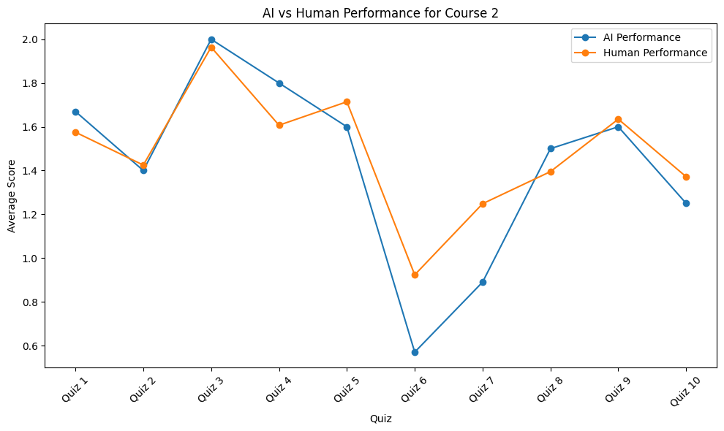
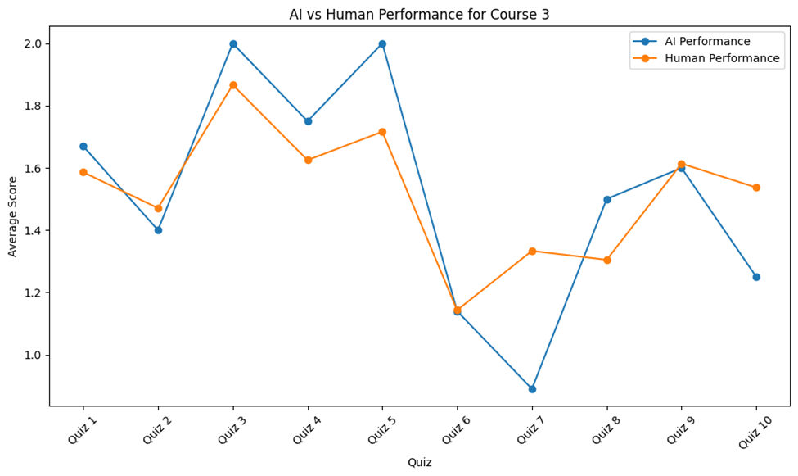
Research Results

Slide 20
Key Findings – Student Performance
Initial Score Decline: Students initially scored lower on colloquial questions due to unfamiliar dialect and novel linguistic complexity.
Adaptive Improvement: Gradual performance gains show cognitive acclimation and enhanced engagement with colloquial language stimuli.
Cluster Analysis Insights: Learner response clusters indicate differentiated engagement patterns, revealing varied adaptation rates and cognitive processing strategies.

Slide 21
Key Findings – AI Performance
Comparable Accuracy on Traditional Items: ChatGPT 3.5 demonstrated high accuracy on classical questions, mirroring human respondent performance levels.
Performance Drop on Colloquial Items: A significant accuracy decline occurred with colloquial dialect questions, reflecting AI's difficulty processing non-standard linguistic variations.
Empirical Validation of CET-AIA: Findings confirm CET-AIA’s effectiveness in embedding AI-resistant features through culturally rich colloquial questioning strategies.

Slide 22
Implications for Arabic Language Education
Addressing Diglossic Complexity: CET-AIA bridges classical and colloquial Arabic, harmonizing assessments with inherent diglossic linguistic dynamics.
Culturally Relevant Contextualization: Promotes context-rich, culturally grounded assessments enhancing authentic language comprehension and learner motivation.
Inclusivity for Diverse Learners: Fosters equitable engagement by accommodating varied dialectical backgrounds, supporting inclusivity and diverse learner profiles.

Slide 23
Policy and Pedagogical Implications
Ethical AI Integration Policies: Implement strict educational AI usage guidelines explicitly curbing unauthorized assistance to uphold assessment integrity.
Educator Training in Colloquial Design: Develop specialized professional programs equipping educators with skills to craft culturally relevant colloquial assessments.
Influencing Future AI Development: Promote AI innovation prioritizing transparency, fairness, and educational ethical standards aligning with colloquial engagement frameworks.

Slide 24
Limitations & Future Directions
Quasi-Experimental Constraints: Limited sample diversity restricts generalizability, necessitating broader demographic inclusion for robust validation.
Cross-Disciplinary Expansion: Encourage integration of linguistic, AI ethics, and educational psychology for comprehensive CET-AIA framework refinement.
Linguistic and Technical Enhancements: Advocate iterative improvements targeting dialectal nuance accuracy and AI detection algorithm sophistication to reinforce framework efficacy.

Slide 25
Dr. Chokri Kooli
PhD. MA. Professor | Researcher | Public Policy Analyst
Faculty of social sciences| Departement of Management | Royal military college |Canada
Graduate school of Public and International affairs| University of Ottawa|Canada
Editor-in-Chief, Avicenna, Public Health Journal
https://www.qscience.com/content/journals/avi
Ckooli@uottawa.ca

