Slide 1
Frameworks & Assessment Scales in Arabic Language Education
Arabic Language Education Forum
Virgina Commonwealth University, May 2nd 2025
Presenter: Dr Hanan Khalifa, Chief Academic Officer, Miqyas Al Dhad
Notes:
Role of Standards and Frameworks in Language Education
Focus on forthcoming Pan-Arab Framework (supporting educators)

Slide 2
Scene Setting
No one framework is better than the other.
Where frameworks fall short is when they are used as a defined set of attainment targets assuming equal ability to learn, equal motivation, equality quality of teaching and input
Most frameworks tend to focus on one educational element and exclude aspects of coherence between these elements.
But, we need them for consistency, planning, reference, & direction

Slide 3
Examples of Arabic Language Frameworks
Arabic Origin
English Origin with Arabic Translation/ Adaptation
Council of Europe (2001) CEFR. Arabic version (2006). https://rm.coe.int/CoERMPublicCommonSearchServices/DisplayDCTMContent?documentId=09000016806d8875
Council of Europe (2020) Companion volume to the CEFR. Arabic version (2021) https://book.coe.int/en/education-and-modern-languages/11060-pdf-common-european-framework-of-reference-for-languages-learning-teaching-assessment-companion-volume-arabic-version.html
ACTFL proficiency guidelines
Interagency Language Roundtable (ILR) Scale
Ministries of Education National standards and curricula for Arabic Language
Miqyas Al Dhad ( forthcoming 2025), powered by Lexile Framework for Reading
Arab Bureau of Education for the Gulf States (2023) Framework of Reference for teaching Arabic to speakers of other languages.
Qatar Foundation (2022) Arabic Level Descriptors for K-12 , https://rm.coe.int/k-12-arabic-language-reference-level-descriptions-based-on-cefr-concep/1680ae495a
Arabic Thought Foundation (2021), Arabi21 project
Queen Rania Teacher Academy (2017) Standards for teaching Arabic to native speakers.

Slide 4
Arabic Language Initiatives – a whistlestop tour
Readability
Off the shelf Assessment
Arabic Lexile (Miqyas Al Dhad, forthcoming 2025)
New York University Abu Dhabi, Readability level thesaurus for Arabic - Samer project (2022)
Al Futtaim Foundation, Aghsan Project for levelled readers (2018 – present)
Criteria For Classifying The Levels Of Arabic Texts (Taha, 2017)
Qiyas Measures Arabic language skills for academic and professional use in Saudi Arabia.
Hamza Measures Arabic language skills for academic and professional use at a regional level.
CIMA (The International Certificate for Proficiency in Arabic) measures proficiency in MSA, globally recognised
Mubakkir evaluates early readers’ performance across critical pre-literacy, and early literacy skills
TALA measures Arabic reading and writing proficiency of native Arabic-speaking students.
And many more ……….

Slide 5
Focus on a forthcoming Pan Arab Framework
Miqyas Al Dhad
An eco system designed to improve literacy skills of k-12 Arabic (native) speakers.
A measurement scale that bridges the gap between text complexity and reader proficiency
A tool for learning and assessment content development
An enabler of personalized and culturally responsive learning and assessment

Slide 6
Miqyas Al Dhad
✔
can help you :
benchmark students and monitor their growth through its item bank of proficiency tests
give reading measures to your students via linking studies
provide readability score for your materials via its text analyzer
create assessment content at the right level via its text analyzer
find the right book for the right child, teen and adult thru its online hub
X

Slide 7
Miqyas Al Dhad measurement scale exemplified
A text’s ض measure is its reading complexity
A student’s ض measure is her reading ability level.

Slide 8
Matching Text Complexity to Reader Ability A Rasch model is being developed
Reader Measure | Text Measure | Forecasted comprehension rate
 | 1500 | 25%
 | 1250 | 50% : cognitively challenged
1000 | 1000 | 75% : challenged but not frustrated
 | 750 | 90% : easy & quick read, enjoyable
 | 500 | 95%

Slide 9
Framework development methodology: Triangulation of 3 data sources
How? Field survey a la PIRLS & PISA
Survey design:
Standards & frameworks,
Blueprint
Item writers & reviewers’ recruitment, induction, coordination, training, monitoring & evaluation
Operational readiness,
Field data collection, 110000 students, 9 countries
Reader Performance data
Corpus data
Pairwise study data
Why? Develop an NLP based text readability model
How?
Expert judges compared sets of two passages at a time
Judgement converted to rank-ordering on a linear scale.
Connectivity among forms ensured
Instruments & participants
Opinion X
450+ experts, 18 countries
2000 passages generated & human validated
150 forms, 35 pairs per form. Each form judged by 10 experts
85% agreement levels achieved
How? Sampling, sourcing
Why?
Ensure coverage & representativeness
Generate vocabulary list at each grade
Provide evidence- based sight word list
Utilize texts in pairwise study
Find a book hub

Slide 10
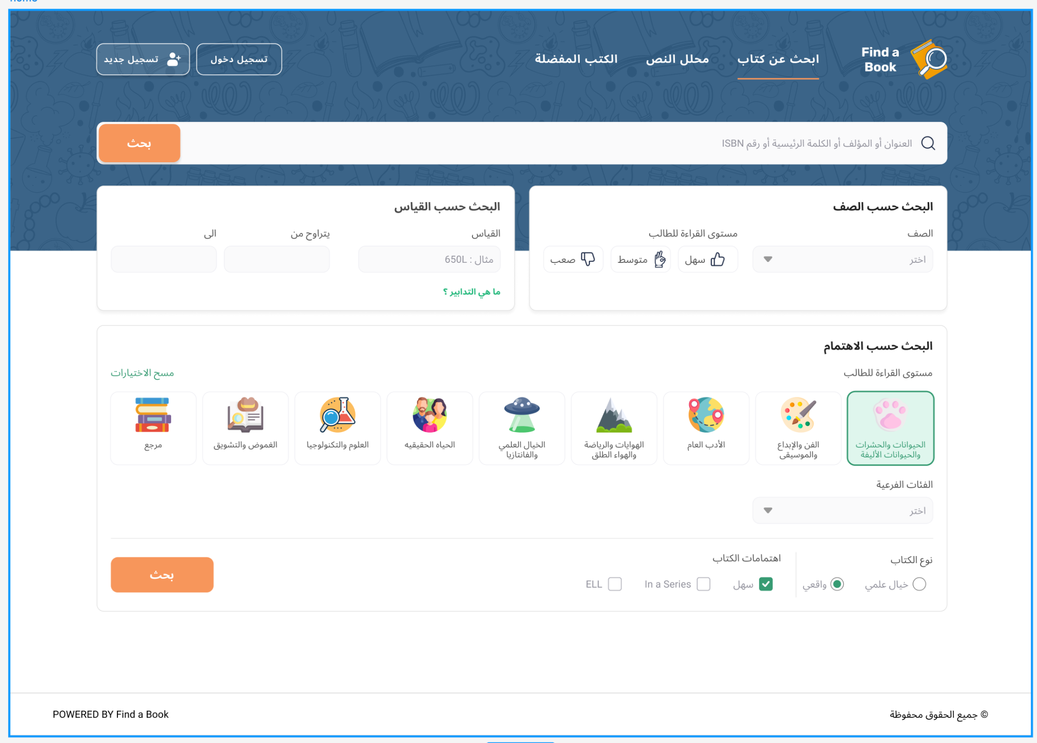

Slide 11
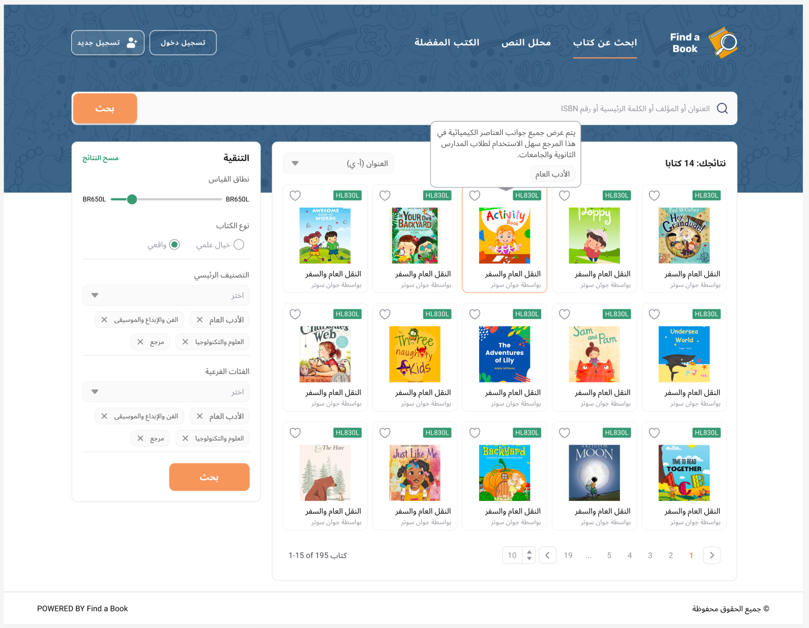

Slide 12
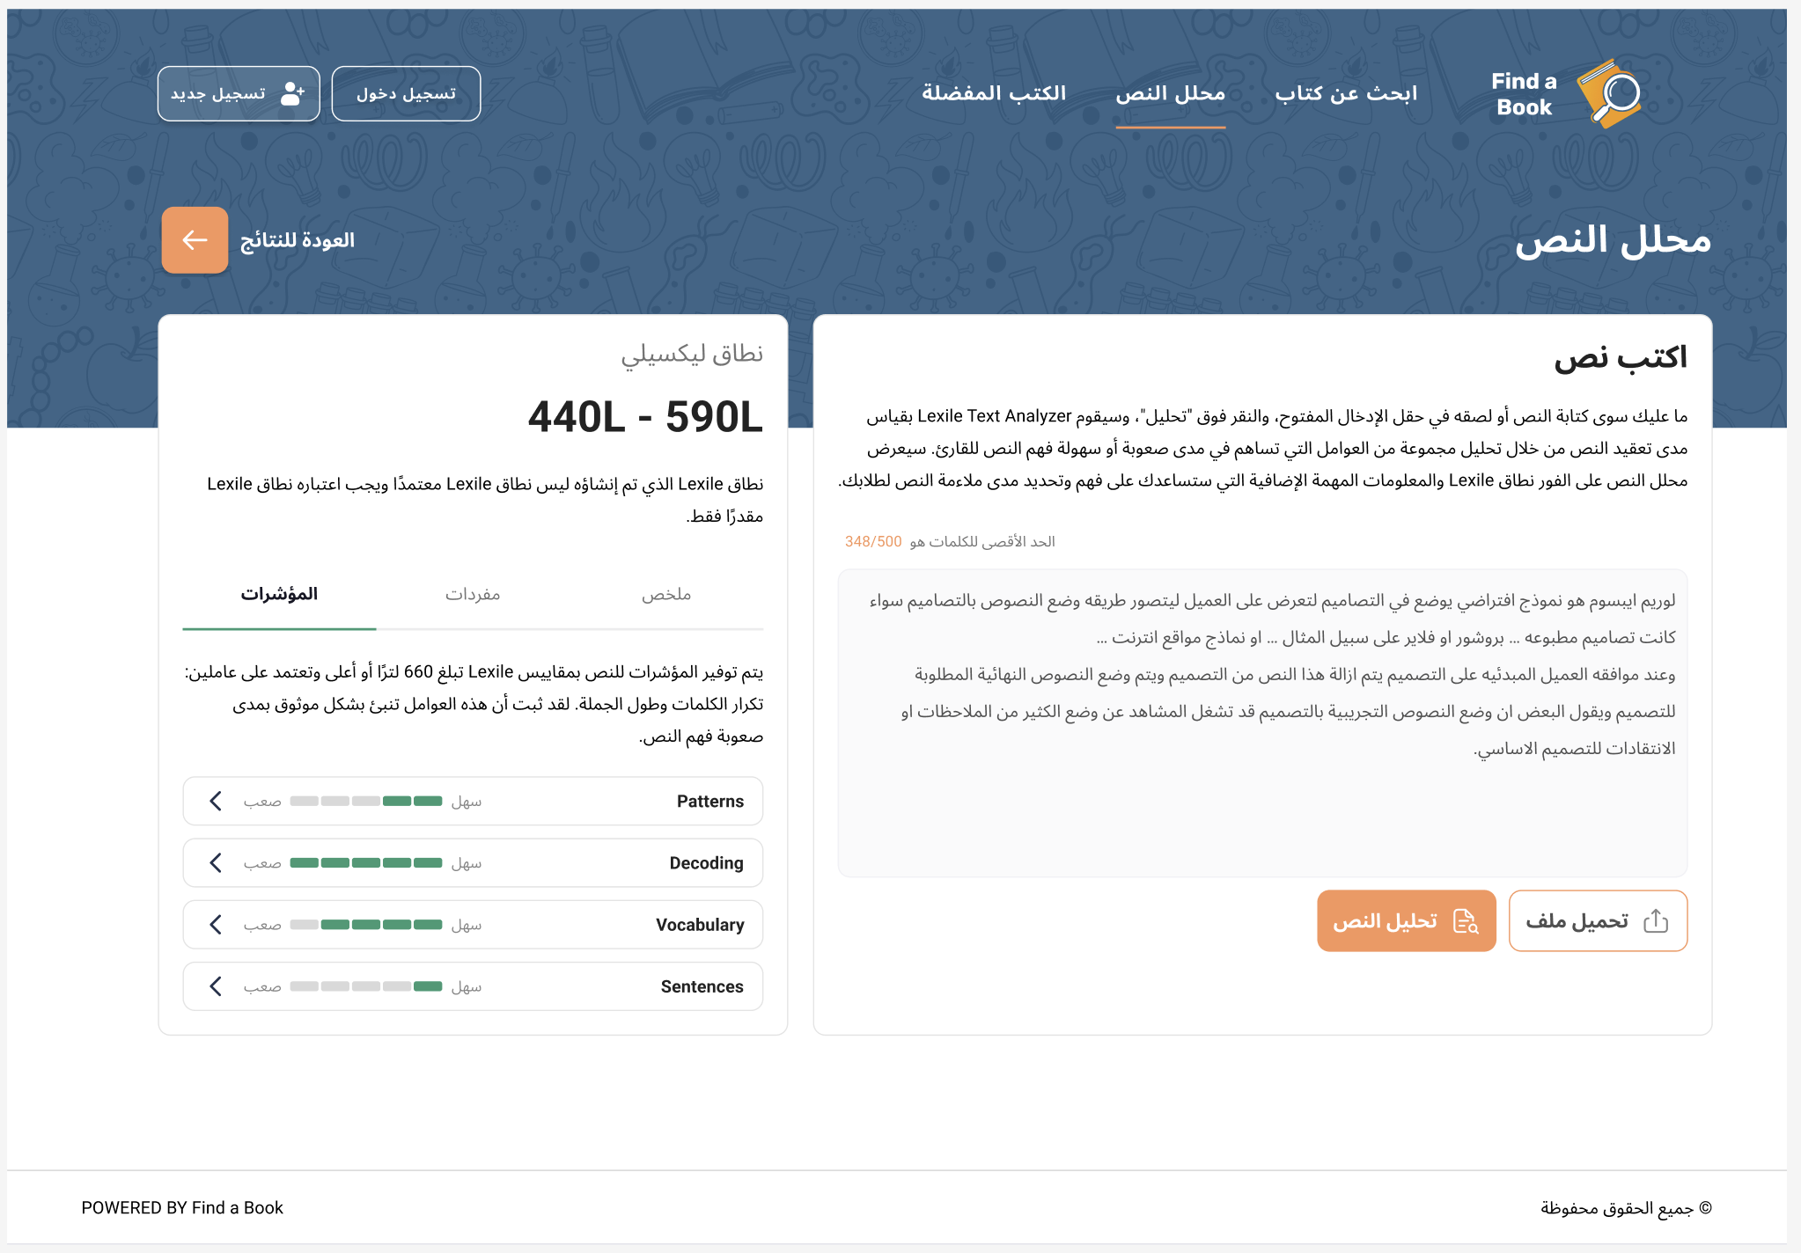
النص يقع ضمن نطاق ضاد: 660 - 670
يمثل هذا النطاق مستوى صعوبة النص من حيث المفردات والتراكيب اللغوية. كلما ارتفع المؤشر، زادت درجة التعقيد في النص.
الضاد

Slide 13
Miqyas Al Dhad
How will we know that it would work?

Slide 14
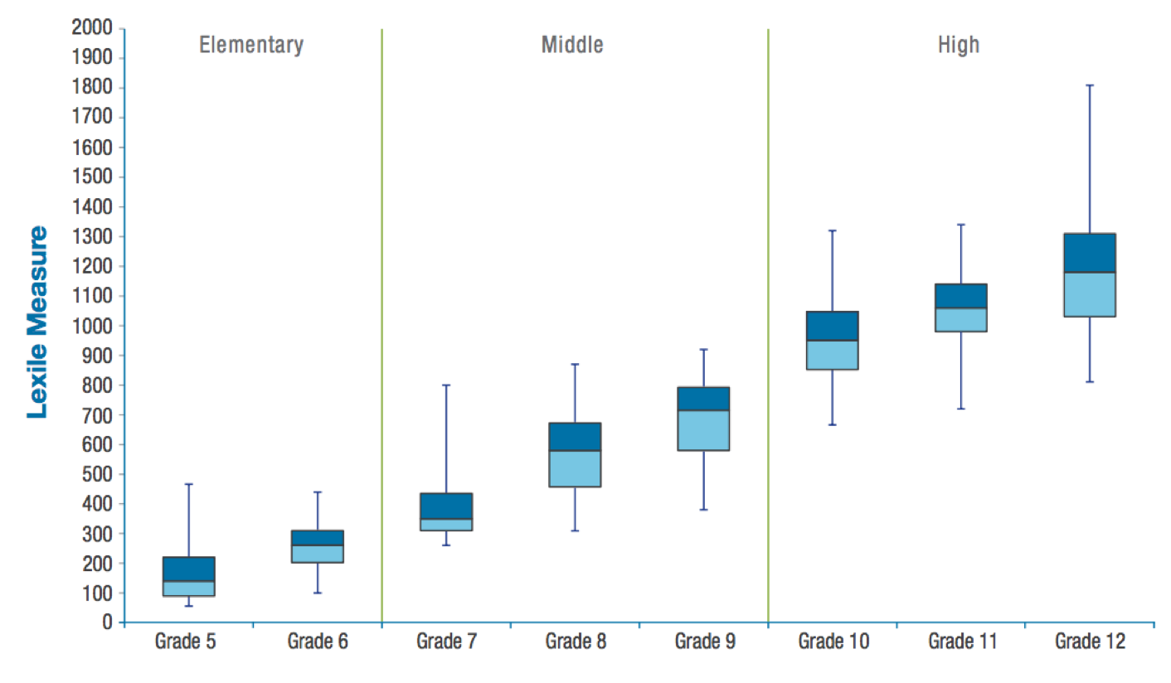
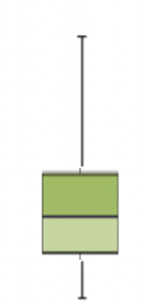
South Korea - Textbooks
(n = 1,056 passages)
≈
CSAT exam

Slide 15
South Korea
(n = 1,056 passages)
≈
CSAT exam

Slide 16
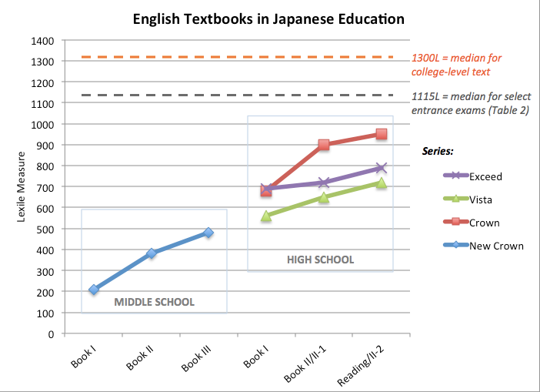
Japan - Textbooks

Slide 17
Japan - Textbooks
1300L = university level texts
1115L = university entrance exams

Slide 18
Q & A
Thank You for participating Dr Hanan Khalifa
linkedin.com/in/hanan-khalifa-phd

